Slide 1
Interlopers, Collaborators, Allies and Resistance: The Complex Positioning of EAP Tutors in the Modern University
Philippa Bunch (p.j.bunch@soton.ac.uk)
Lucy Watson (l.a.watson@reading.ac.uk)

Slide 2
Why the language of conflict?

Slide 3
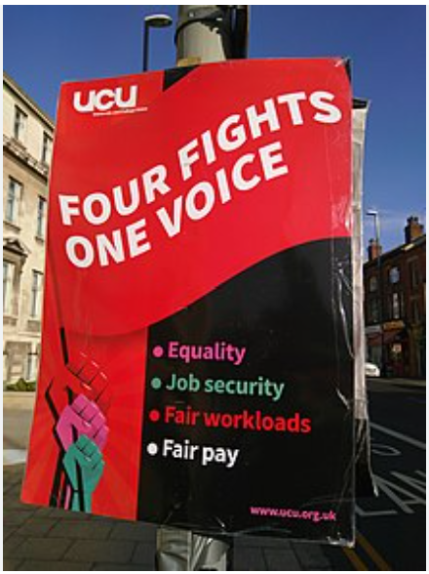
Universities as ‘battlegrounds’
Freedom of Speech ‘woke’ academics, culture wars
UCU (‘cradle to the grave’) versus the marketized model
Boycotting of unis based on conflict and geopolitics

Slide 4
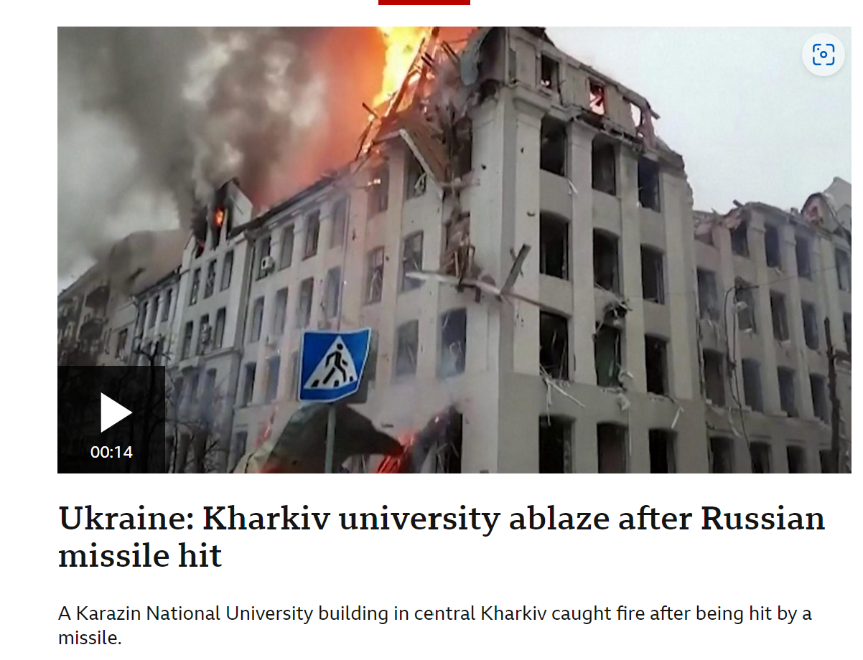
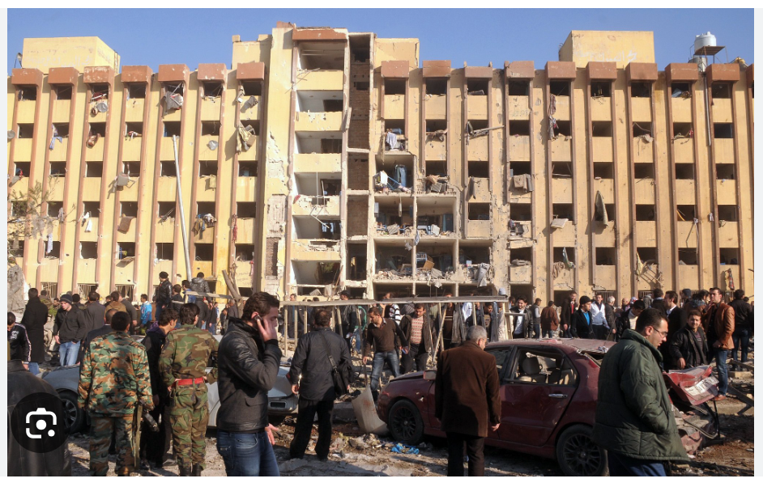
Universities ‘under siege’
Explosions erupt at Aleppo University Credit: Agence France-Presse — Getty Images

Slide 5
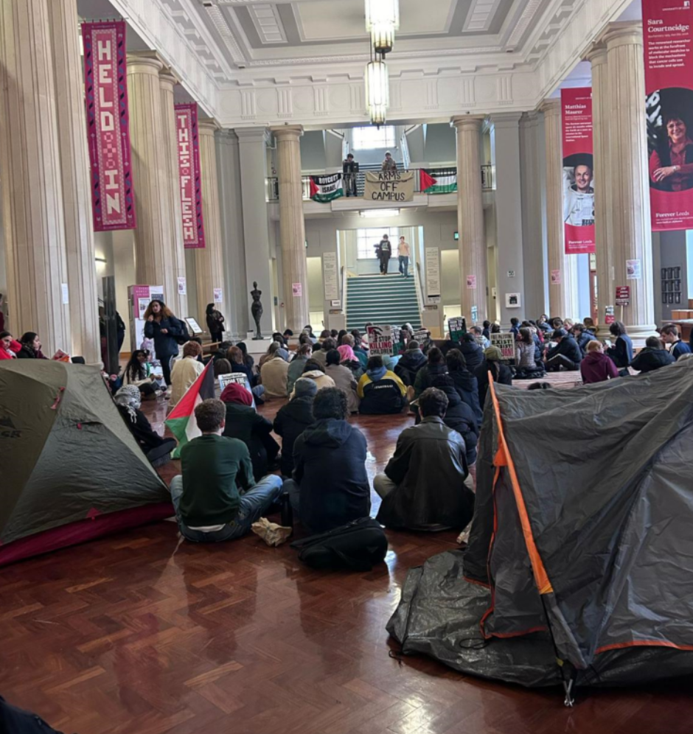
Universities are political spaces, embroiled in global politics

Slide 6
Complex positioning of EAP tutors in the modern university

Slide 7
Some scholarship on EAP identity
EAP teachers are seen in a marginalised service role and lacking a subject of their own (Pennycook, 1997)
Language work with students has been described in gendered terms as ‘Cinderella work’ (Turner, 2004, 2011) [See also Tuck, ‘I’m nobody’s Mum in this university…’]
Recharacterizing operating on the margins as a ‘third space’, offering a degree of freedom for EAP professionals to define themselves (Whitchurch, 2008)
EAP practitioner identity as ‘insider’ of a complex, research-informed academic field OR as an ‘outsider’ providing ‘support activity’ (Ding and Bruce, 2017)
EAP professional identity and importance (or not) of scholarly activity (Taylor, 2019)
Affordances of ethnography for understanding how EAP functions and is understood in cultural contexts (Collins and Holliday, 2022)

Slide 8
Metaphors of conflict as a lens to discuss roles in the modern university
But….
What is the nature of the conflict?
Who is the enemy?

Slide 9
Metaphor | Definition (Cambridge dictionary) | international education ‘stakeholders’
Interloper | ‘someone who becomes involved in an activity or a social group without being asked, or enters a place without permission’ | EAP tutors? Students? Subject lecturers? Librarians? Heads of department/unit heads?
Collaborator | ‘a person who works with an enemy who has taken control of their country’ ‘a person who works together with others for a special purpose’ | Subject lecturers? Researchers? EAP tutors? Study support? Students? Librarians?
Allies | ‘someone who helps and supports someone else’ ‘someone who helps and supports other people who are part of a group that is treated badly or unfairly, although they are not themselves a member of this group’ | Welfare? Recruitment & admissions? Heads of department/unit heads? University senior management?
Resistance | ‘the act of fighting against something that is attacking you, or refusing to accept something’ ‘a force that acts to stop the progress of something or make it slower’ | Subject lecturers? Researchers? EAP tutors? Students? Heads of department/unit heads?

Slide 10
Case study from a neoliberal university

Slide 11
Context
University of Southampton strategy = growth
‘international facing’ PGT masters programmes in Faculty of Arts and Humanities – income generating
Winchester School of Art model – e.g. Global Advertising and Branding, Global Media Management
Exponential growth – numbers have doubled over 5 years. Now have approx. 1600+ international PGT students (mostly Chinese)
Notes:
PB

Slide 12
Local teaching context
Humanities: MA Film and Cultural Management, MA TESOL, MSc Business and Heritage Management
New MA in Global Literary Industries Management (2019) for the English department
Lucy’s disciplinary and teaching background = English Literature/cultural studies (PhD) and EAP (20 years’ experience in UKHE)
Designed a module: ‘Communicating the Cultural Industries’ [interloper + collaborator]
Philippa’s disciplinary and teaching background = English Literature (BA), Applied Linguistics for Language Teaching (MA) and EAP (15 years’ experience in UKHE) [collaborator + ally]
Academic year | Enrolment numbers
2019 | 5
2020 (online) | 8
2021 | 13
2022 | 25+
2023 | 42
Notes:
LW

Slide 13
Some obstacles to collaboration
Institutional:
‘Grow or die’ strategy
Workload pressures
Lack of planning
Emotional:
Feelings of overwhelm
Resistance to change
Worry about lack of experience
Political:
Resistance to growth strategy
Suspicion of impact on academic freedom
Contextual:
Lack of subject-specific expertise
Students’ educational background
Outsourcing of pre-masters
Ethical:
Marketized model of UKHE
International student fees
Lack of welfare support

Slide 14
Understanding concerns of subject lecturers
Lecturers reported fear of being branded racist:
‘But it’s not the students themselves. It’s the sheer number of them and the fact that there has been no planning. We don’t know how to support them and there is no resource for that.’ (Senior lecturer in Film)
‘The problem is, you can’t question any of it. If you do, senior managers just say you are racist’ (Senior lecturer in Film)
Notes:
PB & LW

Slide 15
Understanding concerns of subject lecturers
‘It’s absolutely the most exhausting teaching I do’. (Senior lecturer in Languages and Cultures)
Difficulty adjusting to new ways of teaching:
I can’t just rock up and teach. I have to think so hard how to present it. Even the most basic concepts can’t be assumed. I have to stage everything and think so carefully how I present things. I can’t forget my notes!’ (Senior lecturer in Languages and Cultures)
‘Until [X department ] has to deal with international students, I don’t think they should judge us for voicing our concerns’. (Lecturer in Film)
Notes:
PB/LW

Slide 16
Understanding concerns of subject lecturers
Response to our input on these programmes:
ACIS provided the necessary bridge between the pre-set requirements of a MA programme and the students’ earlier educational background (Senior lecturer in English).
You two have pioneered classroom strategies (related to how concepts are taught and internalised) that a wide range of academics can benefit from (Senior lecturer in English).
Tensions occurred when academic staff were hesitant to change teaching approaches. At that moment, you were instrumental in negotiating gradual change advocated by some staff, and you were important in providing pedagogical models for how such change could happen (Senior lecturer in English).

Slide 17
Putting ‘Critical Care’ at the centre of collaboration

Slide 18
‘The politics of care is an approach to political thought and action that moves beyond the liberal approach which situates care as a finite resource to be distributed among autonomous individuals, or as a necessarily feminine virtue. Instead, those elucidating the politics of care for the contemporary era draw on rich interdisciplinary traditions and social movements to theorize and practice care as an inherently interdependent survival strategy, a foundation for political organizing, and a prefigurative politics for building a world in which all people can live and thrive’. (Woodley et.al, 2021)
Notes:
PB

Slide 19
Theorising care in HEIs
‘…caring as a practice in the contemporary academy frequently involves navigating a tricky tension between caregiving as an undervalued and exhausting chore or even as a form of performative “emotional display” (Salisbury 2013: 48) on one hand, and enactment of a deep commitment and engagement on the other’ (Tuck, 2018)
Articulated in and to the demands of the university, virtuousness can mean over-extending such that it is impossible to stay apace, to be sufficiently responsive, available, intimate, politicized...a good feminist fails if she cannot attend constantly to the nurturing/facilitating project in every domain of her commitment (Berlant 1997: 147)
‘There is a politics to exhaustion. Feeling depleted can be a measure of just what we are up against’ (Ahmed 2013a)
Notes:
LW

Slide 20
‘…caring in academia goes beyond [caring as a practical and demanding activity mostly done by women] to encompass a professional ethic emphasising “receptivity, relatedness and responsiveness rather than rights and rules” (Salisbury 2013: 53)’ (Tuck, 2018)

Slide 21
‘Critical Care’ – a working definition
Critical care acknowledges that ‘care’ in higher education institutional settings is often characterised in gendered ways which undermine its radical potential. To care is to resist a dehumanising system which makes homogenising assumptions about students and those who teach them, and devalues the challenging, time-consuming and skilled work it takes to educate well. To adopt a concept of critical care is to understand that barriers to caring are structural and not personal. It resists attributing blame on a personal level and understands the pressures and power dynamics (both external and internal) which work to position us in competition and conflict with one another.

Slide 22
Diplomats and negotiators
Deficit assumptions | ‘Negotiated settlements’
‘They won’t talk in seminars’ ‘They probably have the language skills to write, but they don’t have the intellectual ability or self-esteem to seek the help in deep level thought that they need’ ‘To them a tutorial is an hour going through everything, explaining every word, making sure you know what’s going on. That’s EAP stuff. I’m not doing that. I want to see you for 15 minutes and I’ll show you where you need to go to get help. But when they leave the room, it’s up to them.’ | CPD sessions led by EAP tutor on facilitating engagement in seminars. Analysing exemplars of international student work with students to identify critical elements of writing Working with students on understanding assignment briefs
Notes:
What does this look like in reality?

Slide 23
Diplomats and negotiators
Poor instructions/briefs | ‘Negotiated settlements’
[REDACTED] | Unpacked the question (with help from others) Rewrote question to explain the key instructions and concepts Ethical dilemma – do you say anything? Consequences – causes tensions, makes you unpopular (killjoy?)

Slide 24
Diplomats and negotiators
Confusing feedback (on a student essay) | ‘Negotiated settlements’
[REDACTED] | EAP tutor compared it to one with a higher mark to analyse the success factors and discussed with a mutual colleague who unpacked the comment and explained what it was referring to and what possible improvements might look like. EAP tutor met with students to explain.

Slide 25
Diplomats and negotiators
Feedback (from subject lecturer on EAP tutor’s slides) | ‘Negotiated settlements’
‘A little bit of feedback on your slides, if I may. I felt they were fantastic and wanted to contribute just two tiny tweaks for the future: I would probably not choose to tell the students that critical commentaries should be objective. Even-handed might be better. We are socially positioned subjects, and we write as such, after all. And secondly, they do not need necessarily to pronounce for or against the text they are commenting on - they can just problematise its critical position.’ | Follow-up discussion and alteration of materials Continuing dialogue between EAP tutor and subject lecturer

Slide 26
Resistance – to what? Why? How?
Caring is not just pastoral. It is a political act and it is work.
Resisting homogenizing assumptions about students (deficit model)
Resisting marketing model that treats them like ‘cash cows’
Resisting quick fixes – advocating for space and time. Allowing space and time to ‘come to voice’ (bell hooks)
Pushing for recognition of the support they deserve
Pushing for resources, time, recognition (via UCU, professionalisation, promotion?)

Slide 27
Limits of resistance
Realities of worklife
Limited control over university’s marketing strategy
Limited ability to push back on investment in unethical projects, collaborations
EAP departments traditionally limited power (service provider)
Extension to concept of critical care:
‘To care critically is to know the realm in which we work but to refuse to comply fully to its rules through small acts of resistance’.

Slide 28
‘Teachers who care, who serve their students, are usually at odds with the environments wherein we teach’
(bell hooks, Teaching in Community, p.19)
What do your small acts of resistance look like?

Slide 29
References
Ahmed, S. 2014. ‘Self-care as Warfare’, feministkilljoys [blog post] Available at: Selfcare as Warfare | feministkilljoys
Ahmed, S. 2013a ‘Feeling Depleted’ https://feministkilljoys.com/2013/11/17/feeling-depleted/last accessed 27/8/2016
Berlant, L. 1997. “Feminism and the Institutions of Intimacy.” The Politics of Research, ed. E. Ann Kaplan and George Levine (New Brunswick, NJ).
Collins, H and Holliday, A. 2022. Ethnography: Expanding the boundaries in EAP Published in Ding, A & Evans, M, (eds) (2022), Social theory for English for academic purposes: foundations and perspectives, Bloomsbury, pp.176-197
Ding, A. & Bruce, I. 2017. The English for Academic Purposes Practitioner: Operating on the Edge of Academia. Basingstoke, UK: Palgrave Macmillan.
Hawkins, H., 2019. Creating care-full academic spaces? The dilemmas of caring in the ‘anxiety machine’. ACME: An International Journal for Critical Geographies, 18(4), pp.816-834.
Hooks, bell. 1994. Teaching To Transgress (1st ed.). London: Routledge.
Hooks, bell. 2013. Teaching Community. 1st edn. Taylor and Francis. Available at: https://www.perlego.com/book/1603402/teaching-community-a-pedagogy-of-hope-pdf.
Pennycook, A. 1997. Cultural Alternatives and Autonomy. P. Benson, P. Voller (Eds.), Autonomy and Independence in Language Learning, Longman, London (1997), pp. 35-53
Salisbury, J. 2013. Emotional Labour and Ethics of Care in Further Education Teaching. In Academic Working Lives: Experience, Practice and Change, eds. L.Gornall, Caryn Cook, Lyn Daunton, Jane Salisbury and Brychan Thomas, 47-66. London: Bloomsbury

Slide 30
References
Taylor, S., 2019. Scholarly activity and EAP professional identity: Tensions and alignments. Garnet Education
Tuck, J. 2018. "I'm nobody's Mum in this university": The gendering of work around student writing in UK higher education. Journal of English for Academic Purposes, 32, 32-41.
Turner, J. 2004. Language as academic purpose. Journal of English for Academic Purposes (3): 95-109
Whitchurch, C. 2008. Shifting identities and blurring boundaries: The emergence of “third space” professionals in UK higher education. Higher Education Quarterly, 62(4), 377–396. https://doi.org/10.1111/j.1468-2273.2008.00387.x
Woodley, D. et.al. 2021. The Politics of Care. Contemporary Political Theory. 20, 890–925. https://doi.org/10.1057/s41296-021-00515-8;

