Slide 1
Building sustainable ESAP expertise and influence across wide scale insessional provision.
Dr Michelle Evans & Prof Bee Bond
The University of Leeds

Slide 2
Plan
A useful conceptual framework.
What is needed to make insessional provision influential and sustainable?
Evolution of insessional timeline and public-facing website.
Some issues regarding expertise and influence.
Ongoing issues and challenges.

Slide 3
Conceptual Framework
Alex Ding & Ian Bruce (2023)
Notes:
This is being used as a way to frame the MA TEAP and has been helpful in thinking about the work undertaken within insessional provision. This means that insessional colleagues are investigating the discourse and genres of subjects but also the disciplinary cultures and values and to some degree, the epistemologies of the disciplines. These areas are included in the categories of literature in the insessional website.

Slide 4
What is needed?
(Ethical) Scholarship
(Ethical) Leadership
(Ethical) Pedagogies
Notes:
Issues related to ethical pedagogies can include: avoiding deficit approaches to teaching, making assumptions about students or cultural stereotypes. It can also include matters relating to inclusion and exclusion ie. Which students have access and the implications of these decisions. This might also involve academic development with colleagues in schools and working with schools.
Ethical leadership issues can include: the approach taken to the provision e.g. school by school and equity issues; negotiations regarding finding and the value/ recognition of insessional colleagues across the academy; engaging in deficit-based negotiations; approach to staffing decisions i.e. cherry picking expertise and developing staff; avoid fracturing and staff silos – so still being part of the LC community (4 days per week only)and being different to not better than. This can also include planning time and space for scholarship and CPD.
Re scholarship, this can involve supporting scholarship ideas and levels of confidence with scholarship; having options and choice in topics; collaborative scholarship projects, unethical practices in scholarship. Also, issues trying to use scholarship to assess impact.

Slide 5
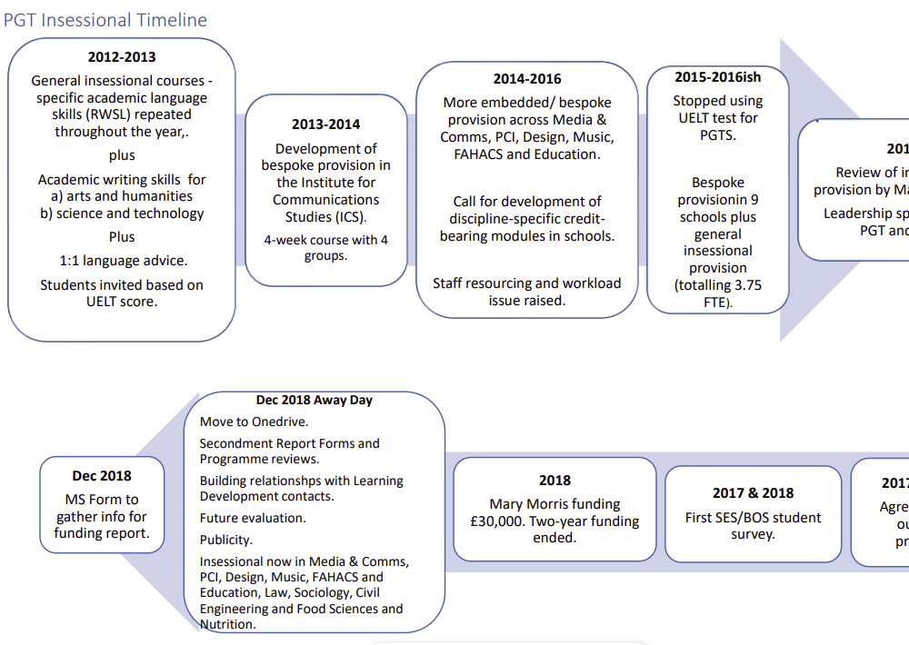
Evolution of insessional provision
Timeline
Website

Slide 6
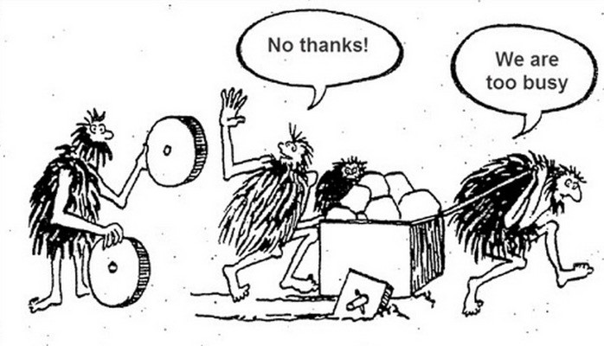
Some issues re expertise and influence.
"It was a really good approach but then Helen left.”
"I don't know where to start."
"We’ve tried that before, it doesn’t work.”
"So, what can you do for us?” (colleague from a school)."
“They know their stuff but can they get on with people?”
“It’s not our job to teach people how to teach”
"If they want our time, they are going to have to pay for it."
www.someecards.com
https://teacherhead.com

Slide 7
Issues and challenges
Please add to the table.

Slide 8
References
Ding, A. & Bruce, I. (2023). Silo Busting in academic language research. BALEAP Biennial Conference: Caution! EAP under DEconstruction. University of Warwick.
Ferguson, G. (1997). Teacher education and LSP: The role of specialized knowledge. In R. Howard & G. Brown (Eds.), Teacher education for languages for specific purposes. Clevedon, England: Multilingual Matters.
Please also refer to the reference list on the insessional website.

