Slide 1
Empowering feedback: boosting student agency in the formative assessment process
Dr. Amy Wallington (Languages, Cultures and Linguistics)
John Bartrick and Dr. Mark Rose (Academic Centre for International Students)
University of Southampton

Slide 2
"Empowering feedback": Two directions
How can we add power to the feedback that students receive?
How can we help this feedback to empower students? What is involved in this process of (intended) empowerment?

Slide 3
Overview
Our context
Challenges with prior assessment methods
About the formative assessment
Task design; formative assessment cycle; success criteria
Scaffolded peer feedback: what it looks like
Outcomes and reflections

Slide 4
Our context
MA ELT/TESOL Studies
n = 180 students in '22/'23
Fully international cohort, predominantly from China
Core pedagogy module
"Principles of Communicative Language Teaching"
Compulsory; must pass
Previously assessed via 2 x summative assessments (equal weighting)
Summative assignment: rationale for a lesson plan
Subject-specific and general academic writing skills

Slide 5
Challenges with the pre-existing approach
High levels of assessment anxiety, particularly given high-stakes assessment context
Lack of opportunities for development of student self-regulation and learner autonomy
Linked to traditional paradigm of “tutor provides feedback – student acts on feedback” (e.g. Nicol 2009; Sadler 2009)
Difficulties engaging with formative assignment feedback has potential to generate further disempowerment (e.g. Green 2019)
Notes:
‘Time saving’ – nuanced concept! Where and when is time being saved?
Green 2019 – also an MA TESOL context – student had little difficulty understanding feedback re: language (e.g. lexical choice, expression) but more difficulty constructing messages re: argument/analysis/task achievement
“The study highlights the importance of shared understandings; of making explicit the formative messages embedded within summative feedback; of the need to embrace a conception of feedback as dialogue rather than monologic telling; of issues of power, and of the need to empower students to seek out and negotiate rather than passively receive feedback; and of the need to understand the production and consumption of feedback within a wider context of affordances and constraints.”

Slide 6
Challenges with the ‘linear’ approach
Complete summative
assignment
Tutors provide feedback
Complete summative assignment
Tutors provide feedback
What happens here?
Few/no opportunities for Ss to engage with feedback in a guided manner
Reduced effectiveness and uptake of feedback; limited opportunities for self-regulation
Continued high anxiety / low self-efficacy for Assignment 2?
Notes:
Linear model diagram

Slide 7
Our aim
Increase student agency and empowerment
How?
Students produce small-scale tasks modelled after summative assignment; iterative module-length process
Allocated to “working groups” of 5-6 peers, in which they reviewed (anonymised) peer examples
Promoting learner autonomy via reduced dependence on teacher and increased opportunity for problem-solving (e.g. de Guerrero & Villamil 1994; Tsui & Ng 2000, in Hu & Lam 2010: 373)
Fortnightly workshop sessions with tutor input: additional feedback ‘strand’
Notes:
How are we using agency vs. empowerment? Is agency empowering???
Why iterative? – increased affordances/likelihood for uptake; providing a forum for discussion/collaboration where previously there was not one
Why is FL/LA beneficial esp. with intl cohorts?
Intl students might be less familiar with Western/Anglo university model which places more emphasis on the individual/autonomy – is this desirable? Arguably yes in terms of allowing them to engage successfully with their courses
Less reticence to share ideas in small groups thanks to FA scaffolding?
“Third, peer review can facilitate the development of learner autonomy by reducing learners’ dependence on teachers (Tsui and Ng 2000) and by fostering learner behaviors that enhance ‘‘the capacity for independent problem solving’’ (de Guerrero and Villamil 1994, p.484; Liu and Sadler 2003; Nelson and Carson 1998).” – Hu & Lam 2010 p.373

Slide 8
EMPOWERMENT
Self-regulation
(Zimmerman 2000)
Agency
Feedback literacy
(Sutton 2012)
“a capacity to take action” (Charteris & Thomas 2017: 162)
Through scaffolded, regular peer feedback
Assessment literacy
(Smith et al. 2012)
Does agency
“feel empowering”?
How did students respond?
Through engagement with success criteria; “noticing” (Schmidt 1990)
More successful engagement with programme?
Notes:
How are we using agency vs. empowerment? Is agency empowering???
AGENCY = “a capacity to take action, an aspect integral to assessment for learning” (Charteris & Thomas 2017: 162)
Agentic students can work dynamically and flexibly with peers to complete tasks and co-construct knowledge (Lantolf & Pavlenko 1995; Yu & Lee 2016)
Ryan & Deci 2017 (seminal) work on self-determination theory : Autonomy within HE as an essential component contributing positively to academic engagement and achievement
Self-regulation (Zimmerman 2000:14): “self-generated thoughts, feelings, and actions… planned and cyclically adapted to the attainment of personal goals”.
Why iterative? – increased affordances/likelihood for uptake; providing a forum for discussion/collaboration where previously there was not one
Why is FL/LA beneficial esp. with intl cohorts?
Intl students might be less familiar with Western/Anglo university model which places more emphasis on the individual/autonomy – is this desirable? Arguably yes in terms of allowing them to engage successfully with their courses -> inc. self-efficacy?
Less reticence to share ideas in small groups thanks to FA scaffolding?
“Third, peer review can facilitate the development of learner autonomy by reducing learners’ dependence on teachers (Tsui and Ng 2000) and by fostering learner behaviors that enhance ‘‘the capacity for independent problem solving’’ (de Guerrero and Villamil 1994, p.484; Liu and Sadler 2003; Nelson and Carson 1998).” – Hu & Lam 2010 p.373

Slide 9
What it looks like: task design
Scaffolding (Wood et al. 1976) via pre-chosen theme and ‘bite-size’ task to gradually build confidence and competence
“Workshop Tasks” :
Linked to theoretical content covered in lectures/seminars
Require subject-specific skills linked to summative assessment (and students' future careers), e.g. designing a lesson stage
e.g. Week 4 Lecture content: Planning Teaching & Learning
Workshop 2 Task:
Outline three lesson tasks following the Pre/While/Post staging structure, related to planning a holiday (vacation). Write a short rationale for your tasks, justifying your choices and explaining how your lesson is communicative.
Smaller-scale task to begin with – planning three activities and a short rationale
Pre-chosen theme to allow focus on communicative principles (main assessment focus)
Strength of communicative design/ rationale assessed in the summative
Notes:
Why so structured? Reduce cognitive load, allow greater focus on subj-specific skills/academic skills
“Too much” empowerment in one go – overwhelming??

Slide 10
What it looks like: the formative assessment cycle
Predominantly facilitated through workshops
Students pre-allocated into "working groups" of 5-6 (approx. 5 working groups per class)
Workshop leaders facilitate discussion of sample work
Ss begin Workshop Task in class in working groups
START
Ss complete formative assessment of cross-allocated sample, using success criteria and template; upload to VLE
Groups complete task outside class and upload to VLE Discussion Board thread
One anonymised sample per class cross-allocated for review
Notes:
Learning continues outside of the classroom – autonomous; empowering as being ‘trusted’ to complete this independently
“Feedback on feedback” – cumulative as well as iterative

Slide 11
What it looks like: feedback
Student
1. Student uploads their group’s task to VLE
2. Non peer-reviewed groups receive written tutor feedback:
“Mediated” autonomy?
Meeting students halfway in terms of expectations around feedback
Partial response to student perception of peer feedback as “less than”
(e.g. Vuogan & Li 2023)
Students are not “left on their own” as sole providers of feedback
Targeted feedback links explicitly to success criteria
Notes:
Empowering them but also meeting them halfway – Ss are not ‘left on their own’

Slide 12
What it looks like: “Success Criteria”
Lipnevich et al. (2014: 540):
Effective FA involves students understanding:
their current performance;
the desired state;
how to “mind the gap” or reduce this difference
An excellent response (Distinction) …
A good response [60-69] ... | Devises a lesson plan/stage that mostly aligns with the chosen learning outcome, although there may be some minor misalignment Includes activities that are mostly appropriate for both the age (adult OR young learner) and level (beginner) of the learners, although one aspect (age/level) may be less strong than the other Shows a solid knowledge of the literature on teaching vocabulary and uses this mostly effectively to justify the pedagogical choices made Demonstrates that principles outlined in LING6041 content (e.g. incidental vs. intentional learning), as well as elements of a wider communicative approach (e.g. student-centred learning) have been considered in the majority of the lesson plan/stage, with, at least some nuance. Any less communicative elements should be mostly justified e.g. with respect to learners' needs
A fair response [50-59] ... | Devises a lesson plan/stage that partly aligns with the chosen learning outcome; some parts may not be well-aligned Includes activities that are partly appropriate for the age (adult OR young learner) and/or level (beginner) of the learners; some aspects of learner characteristics may not have been considered Shows some knowledge of the literature on teaching vocabulary and begin to use this to justify the pedagogical choices made Begins to demonstrate that principles outlined in LING6041 content (e.g. incidental vs. intentional learning), as well as elements of a wider communicative approach (e.g. student-centred learning) have been considered in some parts of the lesson plan/stage. Less communicative elements should be, at least partly, justified
Assessed in the summative assignment:
Alignment of planned activities with learning outcome
Consideration of learner characteristics e.g. age, proficiency
Subject understanding; use of literature to justify pedagogical choices made
Understanding of broader pedagogical principles reinforced throughout module
(Merit)
(Pass)
A weaker response (Fail) …
Notes:
Lipnevich et al 2014: 540 - That is, in order for assessment to facilitate learning, students need to understand the level and nature of their current performance, the desired state of proficiency, and the discrepancy between the actual and the desired state. Further, they need to be able to effectively process that information and work to reduce the difference, or borrowing from the London Underground, “mind the gap.”
Success criteria: raising awareness of the ‘desired state’ and consequently, Ss’ awareness of how they will be assessed (assessment literacy)

Slide 13
Empowering peer feedback: a responsive process
Version 1: Students first choose the success criteria band that best represents the work they are assessing and then complete prompts:
Challenges: Lower engagement with prompt element than hoped
Reflection: Do students have the support they need to autonomously complete this part?
What experience, if any, does this cohort have with giving peer feedback?
We think this example is a [mostly/somewhat] [excellent/good/fair/weaker] response because....
Two things this example has done well:
1)
2)
One thing this example could do to improve:
1)
Notes:
Show evolution – started with written prompts, not brilliant engagement with this -> reflection -> more structured reflection and feedback template (show)
Constant refinement and evolution – reflective practice, responsiveness
Cultural factors:
- Kinsella et al. 2013 - “it is crucial to consider how social and cultural factors, such as the norms and expectations of one’s learning community, may contribute to the efficacy of autonomy-enhancing strategies” (p.13)
Reinforce point about tensions re: Anglo-Western uni expectations regarding autonomy and criticality (inc. of peers) vs. expectations of students from collectivist cultures (REF FOR THIS); opportunities for the development of reflective/evaluative skills (key to self-regulation) may not necessarily be ‘there for the taking’ for all students; need to be quite explicit about what (peer) feedback looks like in order for learners to feel sufficiently empowered to participate in this process

Slide 14
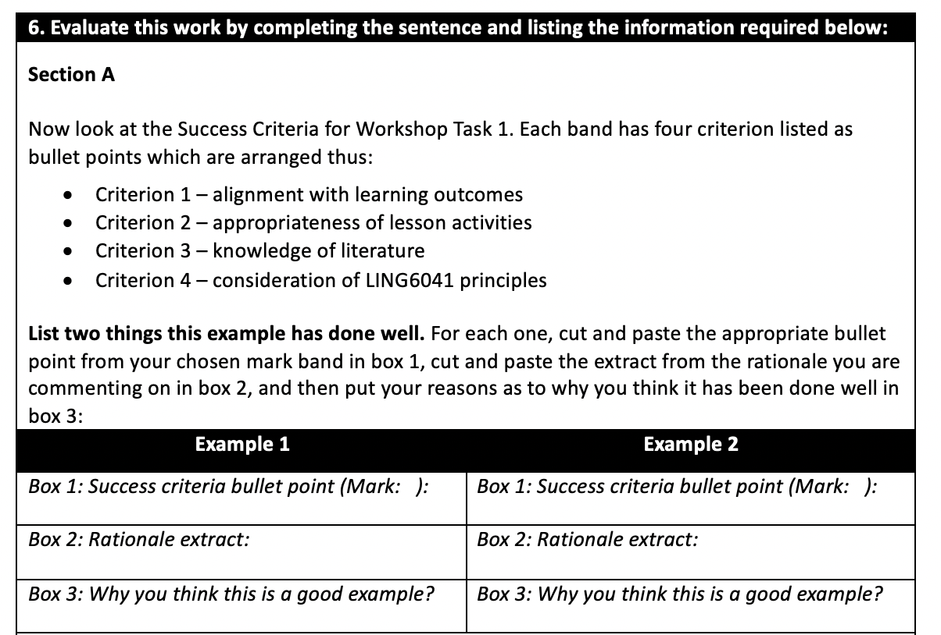
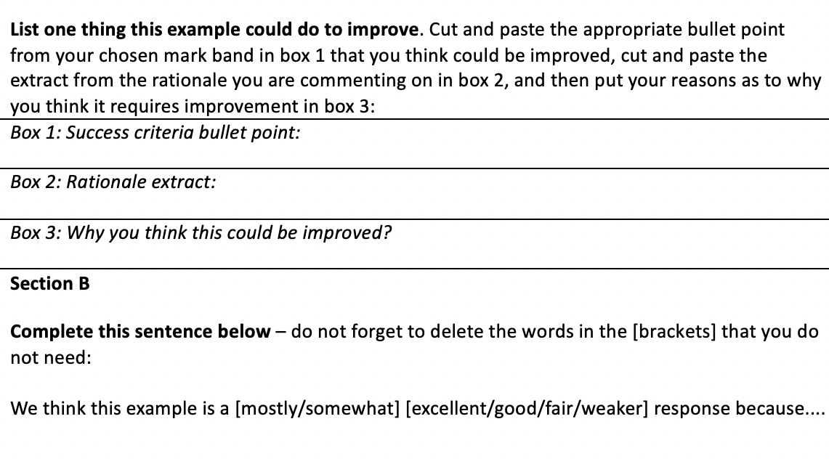
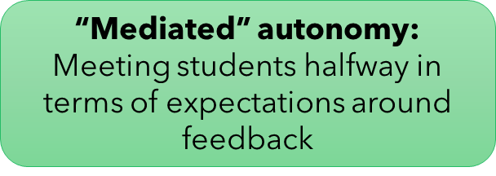
Empowering peer feedback: a responsive process
Version 2: More structured and explicit guidelines ➡️ more engagement
Agency facilitated progressively (e.g. Kinsella et al. 2023)
Notes:
Show evolution – started with written prompts, not brilliant engagement with this -> reflection -> more structured reflection and feedback template (show)
Agency facilitated incrementally rather than all at once in a potentially overwhelming manner; ‘meeting halfway’: seems contradictory but in many ways students’ autonomy is facilitated through support/assistance i.e. not just being ‘left to their own devices’
Constant refinement and evolution – reflective practice, responsiveness
Reinforce point about tensions re: Anglo-Western uni expectations regarding autonomy and criticality (inc. of peers) vs. expectations of students from collectivist cultures (REF FOR THIS); opportunities for the development of reflective/evaluative skills (key to self-regulation) may not necessarily be ‘there for the taking’ for all students; need to be quite explicit about what (peer) feedback looks like in order for learners to feel sufficiently empowered to participate in this process

Slide 15
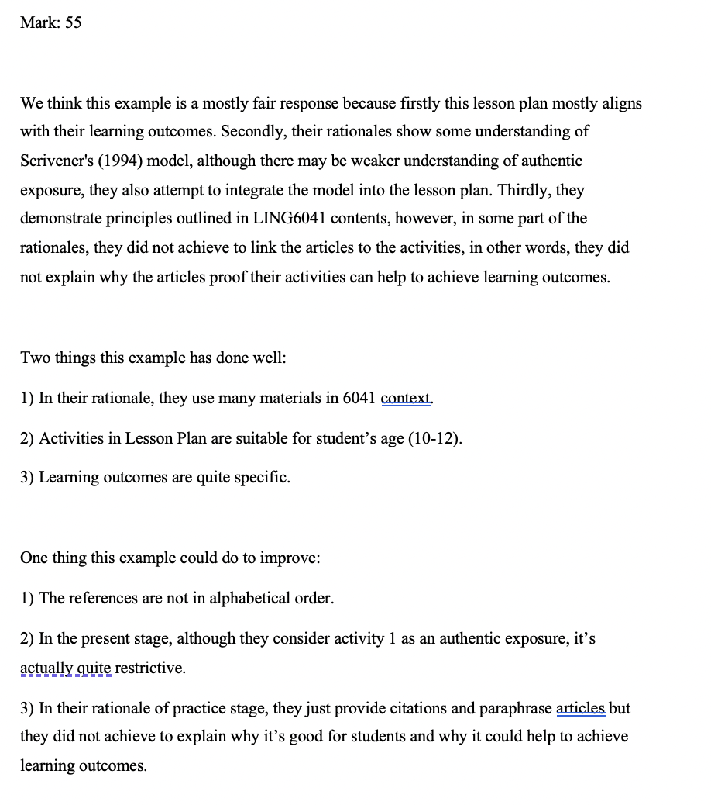
Peer feedback as a vehicle for empowerment : Examples
Peer suggested mark based on evaluation of success criteria
Referring to success criteria when justifying mark given – similarly to how we would provide feedback (assessment literacy)
Awareness of wider academic skills
Developing criticality
Success Criteria
Notes:
LHS: Ss begin by highlighting the parts of success criteria that they felt were the ‘best fit’; this provides a point of departure that they can use in their written responses
NB: This was from an earlier iteration before we introduced the feedback template, but still a good example
Ss have gone beyond what has been asked of them – not robotically completing task but extending it

Slide 16
Student perceptions – Mid-module feedback
What do you like about the module? What should we continue doing?
During workshop, I have the opportunity to share my opinions with my groupmate. I like this very much.
I also prefer workshop tasks and we can also get feedback to review.
Teachers… [k]eep tracking students' feedback and learning process to prevent students from not keeping up.
Teamwork in workshop
After the workshop, I can get feedback so that I know what needs to be improved.
[The module structure] can underpin what we have learned and check whether we can put knowledge into practice, which is useful.
Group discussion is great for fostering our oral English ability
Notes:
Themes:
1. Ss enjoy collaborating with classmates
2. Though not targeted, Ss note beneficial impact on spoken English – may enhance classroom autonomy more broadly if feel more self-efficacious regarding ability to express themselves in English
3. Strong emphasis on appreciating feedback as a tool to check their current understanding and understand how to improve (“minding the gap”), including (4) the continuous aspect facilitated by the FA cycle

Slide 17
Student perceptions – Mid-module feedback
Is there anything you think we should change about the module?
I hope everyone can write their own lesson plans every week, and then the teacher will give detailed one-to-one comments and revision suggestions. Only in this way can I get promoted
Challenges to increasing agency:
1. Low levels of self-regulation – not a ‘quick fix’ scenario
2. Not all are immediately convinced of benefits of group work/feedback and prefer an individual approach
3. Perception that teacher feedback is superior to student feedback
Too much group work, individual work should be encouraged
It rarely exercises my ability of writing lesson plans, because I can only write some parts in group cooperation each time, and the feedback is from students, which is not professional
Honestly, I will not read others' work after the class.
Group members are not active
Notes:
Check Vuogan & Li for refs??
How have we responded? Quite a pragmatic approach - what happens when reality on the ground meets our ideas/expectations? Compromising, linked to logistical constraints too! Has to work in the real world
Continuous and ongoing reflection – reflective practice also a cycle!

Slide 18
Wider outcomes
Summative performance
Average score 1.5 marks higher than ‘22/’23
Reduction in failed scripts and in scripts achieving lowest passing category
(“Pass”/ 50-59)
Increase in scripts in two highest categories: Merit (60-69) +13.8%, now the most frequently-awarded category (was Pass); Distinction (70+) +2.1%
Progressive perception shift
From ‘23/’24 Semester 2 mid-term feedback:
“I think I gradually learned how to justify my lesson plan… The formative assessment is also helpful because it’s a kind of example of justification for us to reflect on our learning.”
Notes:
Average score increased 1.4 marks from ‘22/’23
small reduction (n = 1) in the number of failed scripts, and a 15.2% reduction in scripts achieving a Pass (across a comparable number of scripts, n = 182 in 23/24 vs. n = 179 in 22/23).
This change results from an increase of students achieving Merits (13.8% more than last year) and, to a lesser extent, Distinctions (2.1% more than last year).
We also see a change in the most frequently-awarded mark category, which was Pass last year and now Merit this year by a substantial margin.
Re: perception shift: this is f/b from the current semester, after Ss had been exposed to FA cycle in Sem 1 and again in current sem – takes time?

Slide 19
Longer-term outcomes: Formative assessment as a vehicle for self-regulation?
Email communication from student
…
Notes:
Taking initiative by going beyond what is requested as part of the FA cycle – agency
Evidencing uptake and implementation of feedback
HOWEVER notice that this is in response to tutor feedback (not peer feedback) – persistent ideologies around superiority of tutor feedback over peer feedback (Vuogan & Li??) which may take some time to evolve/shift

Slide 20
References
Charteris, J., & Thomas, E. (2017) Uncovering ‘unwelcome truths’ through student voice: Teacher inquiry into agency and student assessment literacy. Teaching Education, 28(2), pp.162-177. https://doi.org/10.1080/10476210.2016.1229291
Evans, C. (2013). Making sense of assessment feedback in higher education. Review of Educational Research, 83(1), 70–120.
Green, S. (2019) What students don’t make of feedback in higher education: An illustrative study. Journal of English for Academic Purposes, 38. pp.83-94. doi: https://doi.org/10.1016/j.jeap.2019.01.010
Hu, G. & Lam, S.T.E. (2010) Issues of cultural appropriateness and pedagogical efficacy: exploring peer review in a second language writing class. Instructional Science, 38. pp.371-394. doi: https://doi.org/10.1007/s11251-008-9086-1
Kinsella, M. & Wyatt, J. & Nestor, N. & Last, J. & Rackard, S. (2023): Fostering students’ autonomy within higher education: the relational roots of student adviser supports. Irish Educational Studies. doi: https://doi.org/10.1080/03323315.2023.2201229
Lantolf, J.P. & Pavlenko, A. (1995) Sociocultural theory and second language acquisition. Annual Review of Applied Linguistics, 15. pp.108-124
Lipnevich, A.A. & McCallen, L.N. & Pace Miles, K. & Smith, J.K. (2013) Mind the gap! Students’ use of exemplars and detailed rubrics as formative assessment. Instructional Science, 42. pp.539-559. doi: https://doi.org/10.1007/s11251-013-9299-9
Nicol , D. (2009) Assessment for learner self-regulation: Enhancing achievement in the first year using learning technologies. Assessment & Evaluation in Higher Education, 34(3). pp.335–352 .
Sadler, D.R. (2009) Indeterminacy in the use of preset criteria for assessment and grading. Assessment & Evaluation in Higher Education, 34(2). pp.159–179
Schmidt, R. W. (1990). The role of consciousness in second language learning. Applied linguistics, 11(2). pp.129-158.
Smith, C.D. & Worsfold, K. & Davies, L. & Fisher, R. & McPhail, R. (2013) Assessment literacy and student learning: the case for explicitly developing students ‘assessment literacy’. Assessment & Evaluation in Higher Education, 38:1. pp.44-60, doi: https://doi.org/10.1080/02602938.2011.598636
Sutton, P. (2012) Conceptualizing Feedback Literacy: Knowing, Being, and Acting. Innovations in Education and Teaching International, 49(1). pp.31–40.doi: https://doi.org/10.1080/14703297.2012.647781
Wood, D., Bruner, J.S., & Ross, G. (1976). The role of tutoring in problem solving. Journal of Child Psychology and Psychiatry, and Allied Disciplines, 17(2). pp.89–100. doi:10.1111/j.1469-7610.1976.tb00381.x
Vuogan, A. & Li, S. (2023) Examining the Effectiveness of Peer Feedback in Second Language Writing: A Meta-Analysis. TESOL Quarterly, 57. pp.1115-1138. doi: https://doi.org/10.1002/tesq.3178
Yu, S. & Lee, I. (2016) Exploring Chinese students’ strategy use in a cooperative peer feedback writing group. System, 58. pp.1-11. doi: http://dx.doi.org/10.1016/j.system.2016.02.005
Zimmerman, B.J. (2000) Chapter 2 - Attaining Self-Regulation: A Social Cognitive Perspective IN: Boekaerts, M. & Pintrich, P.R. & Zeidner, M. (eds.) Handbook of Self-Regulation. Academic Press. pp.13-39. doi: https://doi.org/10.1016/B978-012109890-2/50031-7
Notes:
Rollinson, P. (2005). Using peer feedback in the ESL writing class. ELT Journal, 59, 23–30. doi: 10.1093/elt/cci003.

Slide 21
Thanks for your attention! Any questions?
Resource sharing (success criteria, feedback templates):
Requests welcomed via email to Amy (A.J.F.Wallington@soton.ac.uk)

Slide 22
Workload implications
Complete summative
assignment
Tutors provide feedback
Complete summative assignment
Tutors provide feedback
Evans 2013: uptake of feedback is critical, but equally key are the demands of feedback provision on instructors
Summative 2000-word assessment – 180 scripts x 45 mins = 135 hours
+ moderation
Revised formative assessment:
36 groups x 20-30 mins = 12-18 hours x 5 weeks = 60-90 hours
Average approx. 70-75 hours total

