Slide 1
The glue that holds collaborative endeavours together: intra-personal relationships
BALEAP PIM Conference 2024
Vicky Collins: International Study & Language Institute
Sue Blackett: Henley Business School

Slide 2
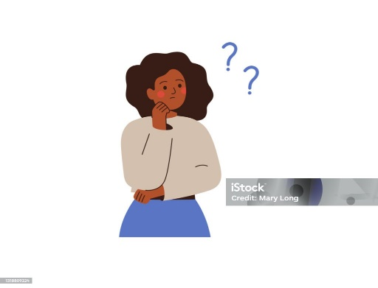
Introduction
Align EAP resources with the subject needs of Postgraduate Accounting & Finance students → prepare students to write a case study by
Vicky Collins, Associate Professor in EAP
Sue Blackett,
Associate Professor in Accounting Education
Collaboration
Coordination
Cooperation

Slide 3
Timeline
Coordination / Collaboration
Lockdown – sharing practice and experiences
Outputs: journal article published, presentation at international conference
Secured university funding for T&L intervention toolkit project and completed research
Cooperation / Coordination
SB → takes over convenorship of 2 Accounting & Finance Modules
VC→ takes over leadership of Academic English for Postgraduate Accounting & Finance students.
Exchanges begin
Today: BALEAP PIM Conference
2017-18
2020-21
2024
2019
2022-23
Collaboration Secured additional funding for T & L to support Accounting & Finance students in the Spring term
(workshops)
Coordination / Collaboration
British Accounting & Finance Association conference research presentation
Completion and university-wide release of intervention toolkit for international students.

Slide 4
Collaboration in today’s context
What makes interdisciplinary collaboration easier today? →More feasible due to increased technologies.
What facilitates collaboration? →Departments/Institutions/the sector
Why is it seen as good? →
promoting innovation
greater impact
Increased productivity
Improved chances of securing funding (Cummings and Kiesler, 2008; Lewis, 2015)

Slide 5
Challenges to interdisciplinary collaborations
Collaboration between subject and EAP teachers
might not always go smoothly (Alhassan et al., 2022,p.4)
1.Different School cultures, schedules, time
3. Perceived status
differences
→The social bonds may be
comparatively weaker
→Difficulty of developing trust and interdependence.
4. Resistance, scepticism
reservation
2. Different places for output: conferences & publications
Alhassan et al., 2022; Cummings and Keisler, 2005;Luo & Garner, 2017,
Notes:
)

Slide 6
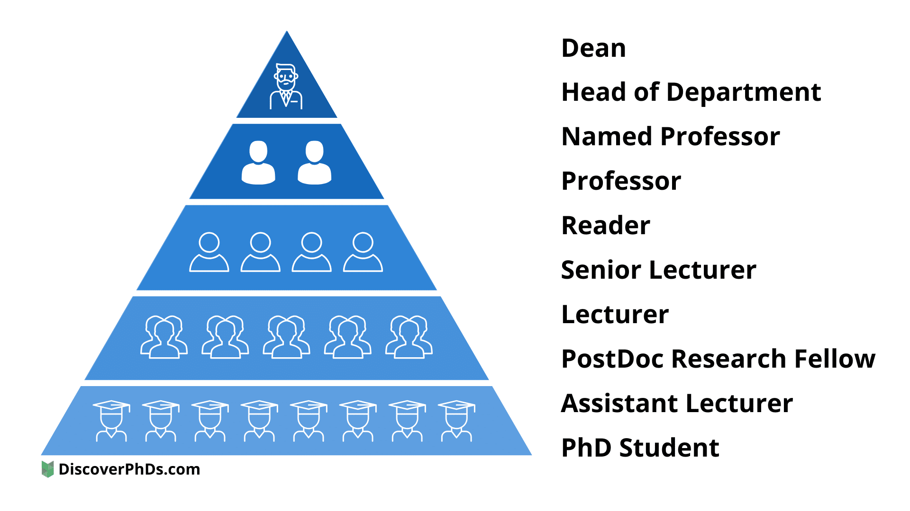
Attributes of collaborators

Slide 7
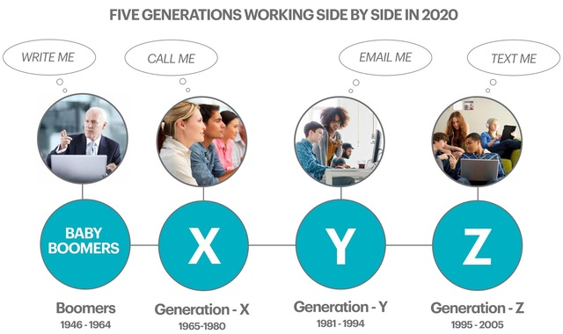
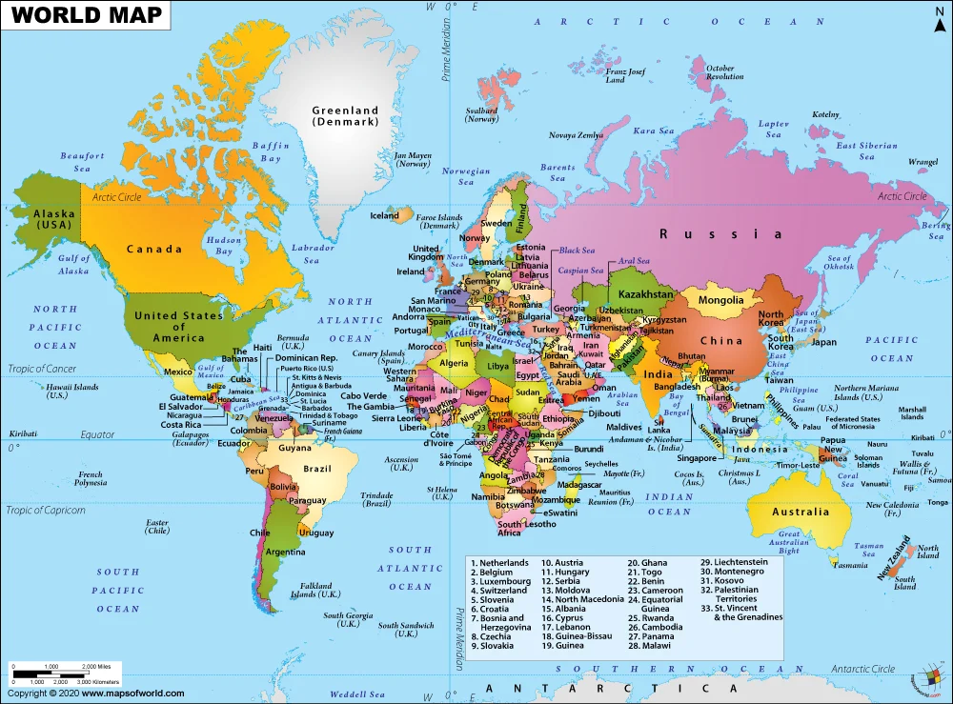
Attributes of collaborators

Slide 8
Motives and strategies for collaboration
Taskmaster: collaborator chosen based on work ethic and ability to stick to deadlines
Mentor: collaborator chosen based on work ethic and ability to stick to deadlines
Buddy: Collaborator based on length of time known to each other, previous collaborations, fun
Tactician: collaborators have complementary skills
Nationalists : collaborators are fluent in their language or same nationality
Followers : have been asked to collaborate with someone
Adapted from Bozeman et al. (2013) p.18

Slide 9
Reflection
Our own scholarship and collaboration → linked to personal values.
Simplification of the notion you can work with (almost) anyone.
Better understanding of collaborative patterns and structures needed esp. amongst Teaching Intensive staff
Think about your collaborators –
Why did you choose them?
How has the relationship been sustained?
What does each person bring to the partnership?

Slide 10
References
Alhassan, A., Bora, S.F., & Abdalla, Y.A. (2022). Collaboration with EAP teachers in English-medium instruction contexts in higher education: Content lecturer perspectives. TESOL Journal, 13(1), 1-15
Bozeman, B., Fay, D., & Slade, C. P. (2013). Research collaboration in universities and academic entrepreneurship: The-state-of-the-art. Journal of Technology Transfer, 38(1), 1–67.
Cummings, J. N., & Kiesler, S. (2005). Collaborative Research across Disciplinary and Organizational Boundaries. Social Studies of Science, 35(5), 703–722.
Dudley-Evans, T., & St John, M.J. (1998). Developments in ESP: A multi-disciplinary approach. Cambridge: Cambridge University Press.
Lewis, J. (2015). Collaborate or die? Interdisciplinary work holds great promise but goal-orientated assumptions must be challenged. Impact of Social Sciences Blog (02 Apr 2015). Website.
Luo, J., & Garner, M. (2017). The challenges and opportunities for English teachers in teaching ESP in China. Journal of Language Teaching and Research, 8(1), 81-86

