Slide 1
Academic literacy in a hostile environment: improving access to university assessments through collaborative teaching
Judy Axelby
Nicolas Moore
Karen Nicholls

Slide 2
Hostile environments
For students:
For us:
Applied University = very varied assignment types and expectations
Diverse population = may not be aware of cultural expectations
32 000 students
Small team (5 lecturers)
No explicit language / literacy policy

Slide 3
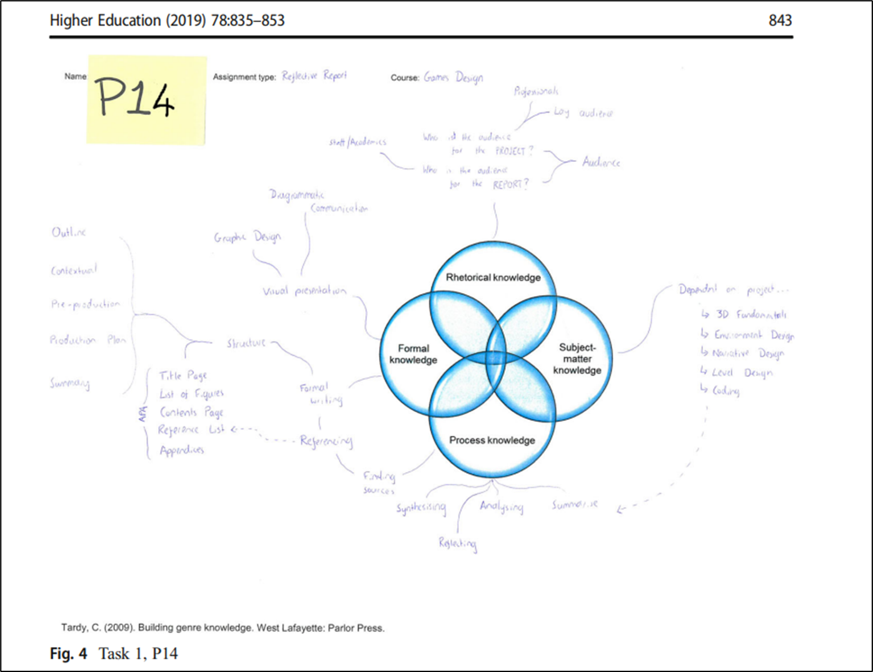
A systematic approach to designing collaborations
Logic model: our theory of change
Hub and spoke working model
Sample of subject lecturer’s explanation of their assignment (McGrath, Negretti, & Nicholls, 2019)

Slide 4
Core elements
Students asked to think about examples of communication that they do, what roles they play
Students would start to write during the sessions
Academic literacy windows (Wingate, 2015)
Student work as the basis of our materials
Explicit use of lecturers’ words as prompts for activities
Where possible, team-taught

Slide 5
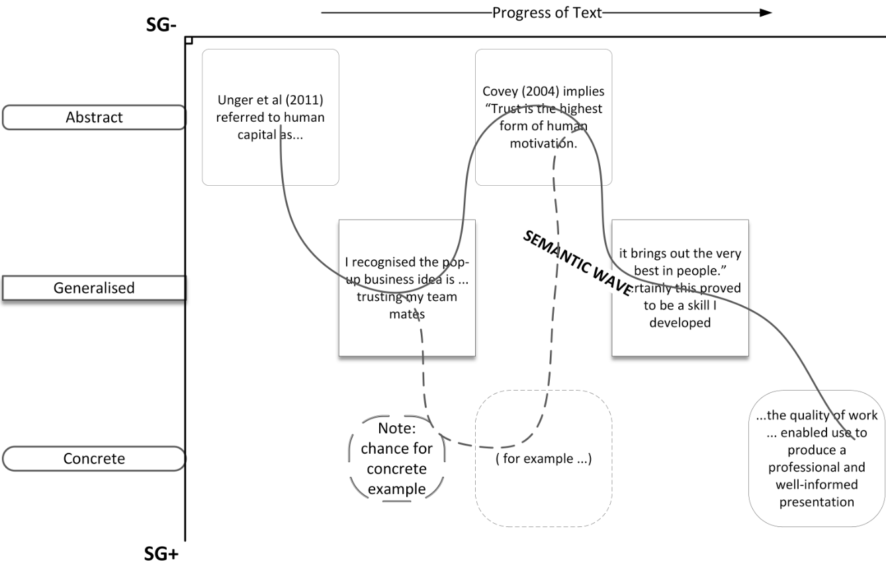
Business intervention
How we met
New course leader, NSS improvement desired
Learning objectives:
to reflect on lessons learnt
to evidence theoretical frameworks in your reflections
to create coherence in writing through a ‘golden thread’
to improve referencing and general accuracy (proofreading)
Enablers
enthusiastic colleague, new course leader
clear pedagogy to work within
students able to see themselves as good communicators
semantic waves as an accessible theory
Inhibitors
attendance (enabler for the project?)

Slide 6
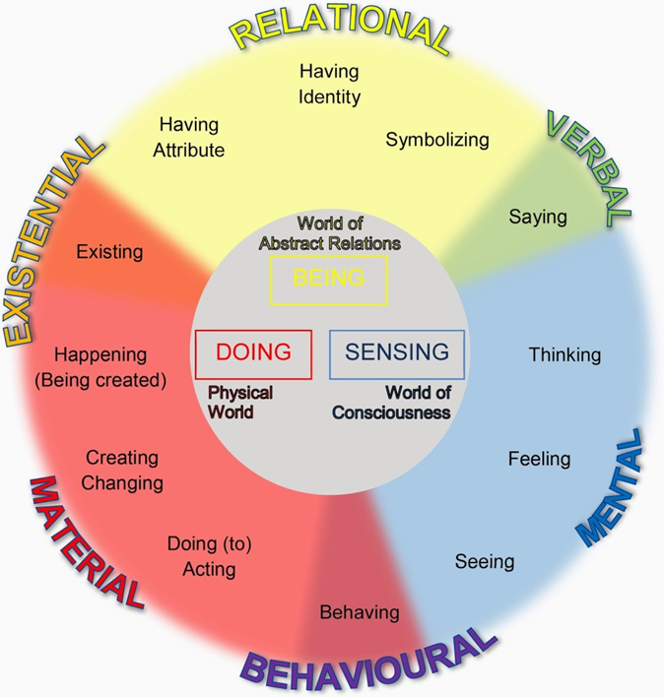
Education intervention
‘I remember, when I was studying A-Level Sociology, that I was expected to memorise the names of numerous theorists and their theories’
How we met:
Module running within our department, course & module lead focussing on attainment gap, extra hours provided for this goal
Learning objectives:
to support reading of complex texts;
to relate personal experience to theory;
to critically review their own learning experiences
to raise awareness of register
Enablers:
running sessions as both education and language content lecturer
extra teaching hours
Inhibitors:
running sessions as both education and language content lecturer
attendance
‘My experience of this style of learning was very positive as the reflection essential to PBL (Downing, Ning & Shin, 2011) provided a feeling of empowerment over my own development’

Slide 7
History intervention
How we met:
Departmental workshop using circles; major changes to the delivery model creating time
Learning objectives:
to have a point and get it across
to engage in the debate
to pick the right facts
Enablers:
awareness of language and writing
TIME – 12 extra hours of provision, of which we taught 6
integration of history module focus and ALL focus
Inhibitors:
attendance (enabler for the project?)
change!

Slide 8
Summary: enabling and inhibiting factors
+
-
equal partnership
motivation to collaborate
research plan and ethical approval
support from above
access to resources
ALL team developing mutual understanding (our CPD)
constantly changing environment
mismatch of expectations
time and timing
student absence
difficulty of accessing impact information
constantly changing environment

Slide 9
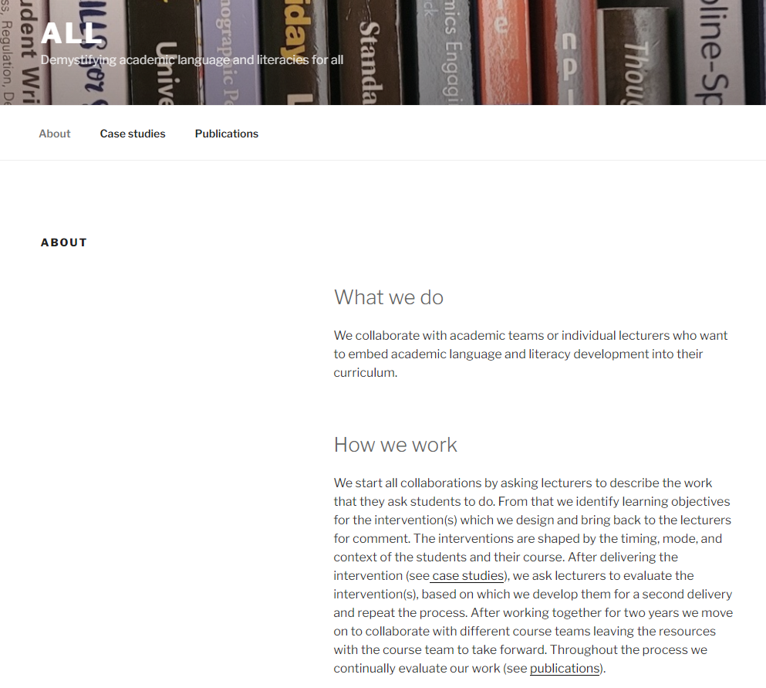
So what?
be available to ‘solve’ other’s problems
be explicit about the theories that underpin our pedagogies
apply for all available resources
present your work
publish
don’t overcommit

Slide 10
Next steps - sustainability strategy:
current
imminent
future
national (macro)
Office for Students
policy
publications
network
building
new staff
mini-module
institutional
(meso)
new lecturer course input
university
policy
local
discussions leading to module level collaborations
funding
for collaboration research
whole course collaboration
course
(micro)

Slide 11
References
Bergman, L. (2016). Supporting academic literacies: university teachers in collaboration for change. Teaching in Higher Education, 21(5), 516-531, DOI: 10.1080/13562517.2016.1160220
Chanock, K. (2017). Learning specialists working with faculty to embed development of academic literacies in disciplinary subjects. In Plane, S., Bazerman, C., Rondelli, F., Donahue, C., Applebee, A., Boré, C., Carlino, P., Marquilló Larruy, M., Rogers, P., & Russell, D. (Eds.) Research on Writing: Multiple Perspectives, pp. 243-262. The WAC Clearinghouse and Centre de Recherche sur les Médiations.
Coffin, C. (2002) The voices of history: Theorizing the interpersonal semantics of historical discourses. Text & Talk, 22(4), 503–528. DOI: 10.1515/text.2002.020
Coffin, C. and Donohue, J. (2014) A language as social semiotic-based approach to teaching and learning in higher education. Language Learning, 64(S1), 1-308
Coldwell, M. & Maxwell, B. (2018). Using evidence-informed logic models to bridge methods in educational evaluation. Review of Education, 6(3), 267-300. DOI: 10.1002/rev3.3151
Kirk, S. (2017). Waves of reflection: seeing knowledge(s) in academic writing. In Kemp, J. (ed), EAP in a rapidly changing landscape: issues, challenges and solutions. Proceedings of the 2015 BALEAP conference. Reading: Garnet
Martin, J.R., Maton, K. and Doran, Y.J. (Eds.) (2020) Accessing academic discourse. Routledge
Maton, K. (2020). Semantic waves: context, complexity and academic discourse. In J.R.Martin, K. Maton, & Y.J. Doran, Min (Eds.) Accessing academic discourse: systemic functional linguistics and legitimation code theory, (pp. 59-85). Routledge.
McGrath, L., Negretti, R. & Nicholls, K. (2019). Hidden expectations: Scaffolding subject specialists’ genre knowledge of the assignments they set. Higher Education, 78, 835-853
Miller, R. T., Mitchell, T. D., & Pessoa, S. (2014). Valued voices: Students’ use of Engagement in argumentative history writing. Linguistics and Education, 28, 107–120. DOI: 10.1016/j.linged.2014.10.002
Tardy, C.M. (2009). Building Genre Knowledge. Parlor Press
Wingate, U. (2006). Doing away with “study skills.” Teaching in Higher Education, 11(4), 457–469. DOI: 10.1080/13562510600874268
Wingate, U. (2015). Academic literacy and student diversity: the case for inclusive practice. Multilingual Matters.
Zappa-Hollman, S. (2018). Collaborations between language and content university instructors: factors and indicators of positive partnerships, International Journal of Bilingual Education and Bilingualism, DOI: 10.1080/13670050.2018.1491946

Slide 12
Questions?

