Slide 1
Redesigning EAP provision to challenge NS/NNS dichotomies
Dr Elidh Harris, CEED
Dr Paula Villegas, IE
University of St Andrews
Notes:
Intro – who are we and what we do – sorry Elidh is not here
Ns/NNs – why are we using this terminology? Our context – awareness of contentiousness – acknowledge my own identity and positionality

Slide 2
Outline
Where we started
Our shared journey
What makes us similar?
What makes us different?
Riding together
Act, assess, adapt.
Our learners’ take
Where to now?
Notes:
The general comment
Despite conscious and ongoing efforts to legitimise and reclaim the value of EAP in the context of higher education (Hyland, 2021), practitioners’ work is often seen as a remedial activity operating in the periphery with little support and recognition (Ding & Bruce, 2017, Hyland & Jiang, 2021). Nevertheless, EAP, specifically in-sessional provision, engages with the fabric of the university and appears in different forms and degrees of specificity (Tibbets & Chapman, 2023). This provision transcends the problematic and contentious native vs non-native speaker division (Hyland, 2016; Flowerdew, 2019) and opens the space for collaboration and exploration between In-sessional Provision and Academic Development Units to challenge the current state and reimagine a coherent and inclusive academic skills provision.

Slide 3
Where we started
CEED (Centre for Educational Enhancement and Development)
One-to-one “study skills” support
All UG and PGT students
Up to 3 per semester in the first instance
Staffed by trained PGR (PhD) tutors
Online (since COVID), up to 60 minutes
Notes:
CEED | University of St Andrews (st-andrews.ac.uk)

Slide 4
Where we started
CEED
Online resources
Study Skills Resource Hub
VLE- Moodle
Asynchronous resources
Workshops (live)
Academic Skills Project
U-Skills (M-Skills, GRADSkills)
Notes:
Online resources-
- Asynchronous resources developed quickly as a response to COVID- covers essay planning, reading for comprehensions, time management, note making, exam prep etc. Mix of videos and downloadable guides
Workshops
- Academic Skills Project– now been running for ten years. CEED provides the structure for PhD/GTAs in individual schools to run a series of subject specific skills workshops for UG students.
- U-Skills programme launched in 2021 and includes a strand of academic skills workshops. M-Skills for Masters and GRADSkills were already in place– run some workshops related to learning development.

Slide 5
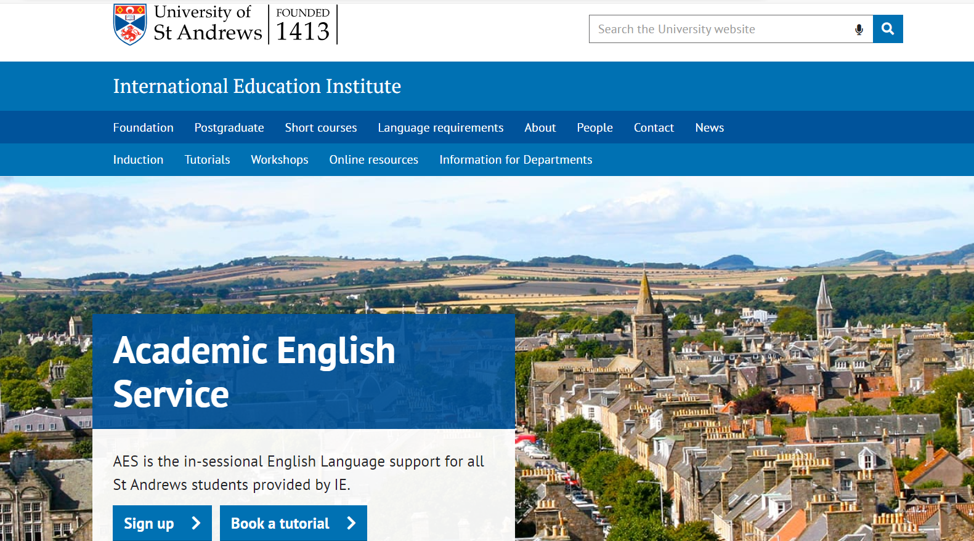
Where we started
Academic English Service (AES, IE)
One-to-one language support
NNS Only
One 25 minutes session per week, otherwise unlimited sessions (UG-PGTs) with any tutor
One 50 minutes session every 3 weeks with the same tutor
Academic English Service - International Education Institute - University of St Andrews (st-andrews.ac.uk)
Notes:
Language Experts/ EAP practitioners

Slide 6
Where we started
Academic English Service (AES, IE)
Collaboration with departments (ESAP)
IE
Biology (sub-honours/ UGs)
Management (sub-honours/ UGs)
OL materials
Moodle
EAP toolkit
Academic English Service (AES, IE)
General Workshops (EGAP)
Open to everyone
OL mostly covering aspects of General Academic Writing
Dissertation Week (in person/ OL)

Slide 7
Our shared journey – what makes us similar?
Academic Skills One-to-One Tutorials – Academic Development Community (st-andrews.ac.uk)
Unique landing page to access our services.
ALL services open to ALL learners
Initial reticence
Deficit perspective
Service capacity
Notes:
When exploring our services, we realise that not a lot makes us different. Both units strive to meet learners where they are and allow them to develop the necessary skills to navigate their academic journeys. So, how could we effectively support our learners, avoid duplication and create an inclusive and effective community? We started by unifying access to our services by having a common landing page. This is a one-stop shop to access the services available. However, we didn’t want to only have accessibility from an ‘ease of finding the information’ perspective. We wanted learners to evaluate which service was adequate for them regardless of their L1. We felt it was the learners’ choice to select the right service for them and in order for them to make an informed choice, we needed to show them what we can and cannot do.
It took us a whole semester to get there. Initially, English L1 had to be referred to the service by either a supervisor or the academic skills one-to-one tutors. As this was our end goal, from the very beginning we wanted to explicitly show how the different one-to-one services could help learners in terms of what they actually need to do.

Slide 8
Our shared journey – what makes us different?
Supporting PGRs
Receptive vs Productive skills
Academic Skills One-to-One Tutorials – Academic Development Community (st-andrews.ac.uk)
Notes:
Thus, identifying the difference in the nature of the one-to-one support. While the Academic English Language would mostly concentrate on productive skills, speaking/ writing, the academic skills one-to-one tutorials would help learners develop receptive skills, helping our learners decode information from lectures (listening) and readings regardless of the discipline. We adopted this arguable artificial division, and I will speak to that in a minute, So we adopted that division based on our tutors’ expertise (EAP practitioners – language expertise, ability to help learners’ identify patterns within their own production VS PGRs familiarity with the disciplinary conventions, ability to discuss their de-coding approach). This approach helps us prioritise language production for the Academic English Language tutorials and other academic skills for the Academic Skills. So, what does this look like in practice?

Slide 9
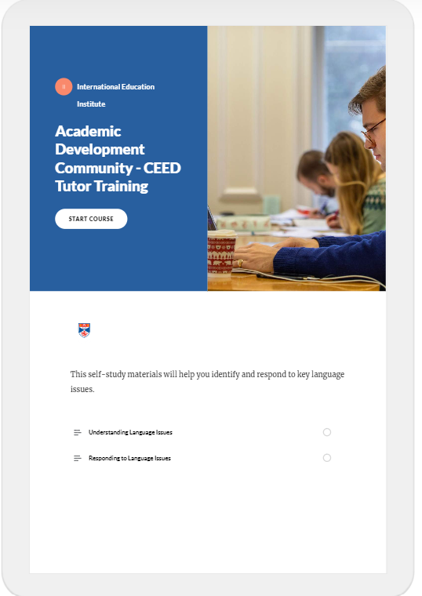
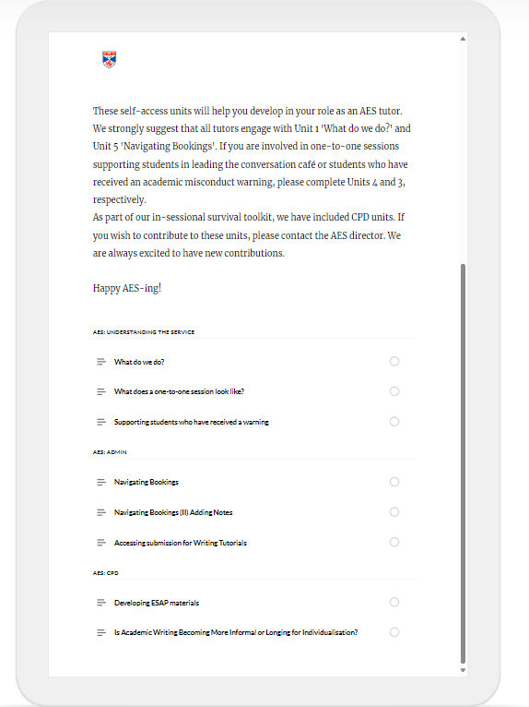
Riding together: Act, assess, adapt
Teacher Training
Identifying Language Issues – Academic Skills Tutors
Focusing on productive skills – Academic Language Tutors
Procedural changes – All tutors

Slide 10
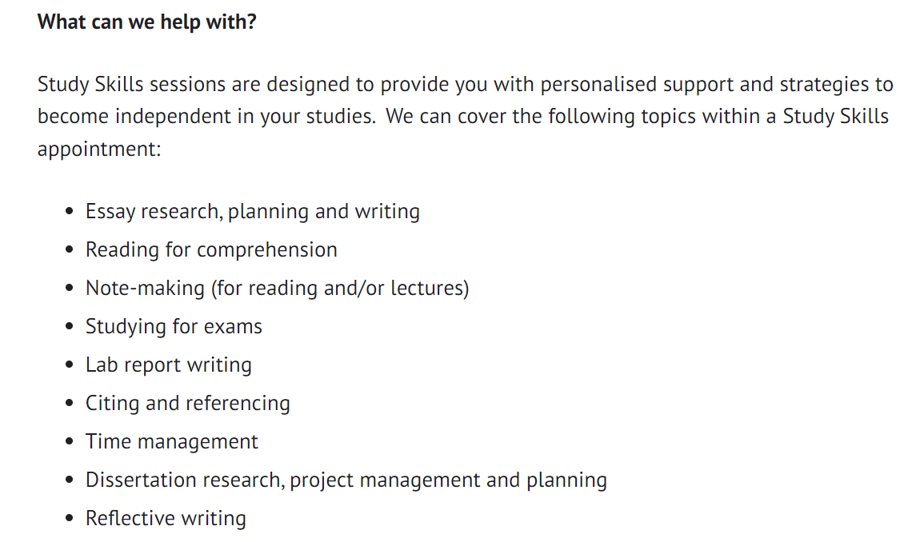
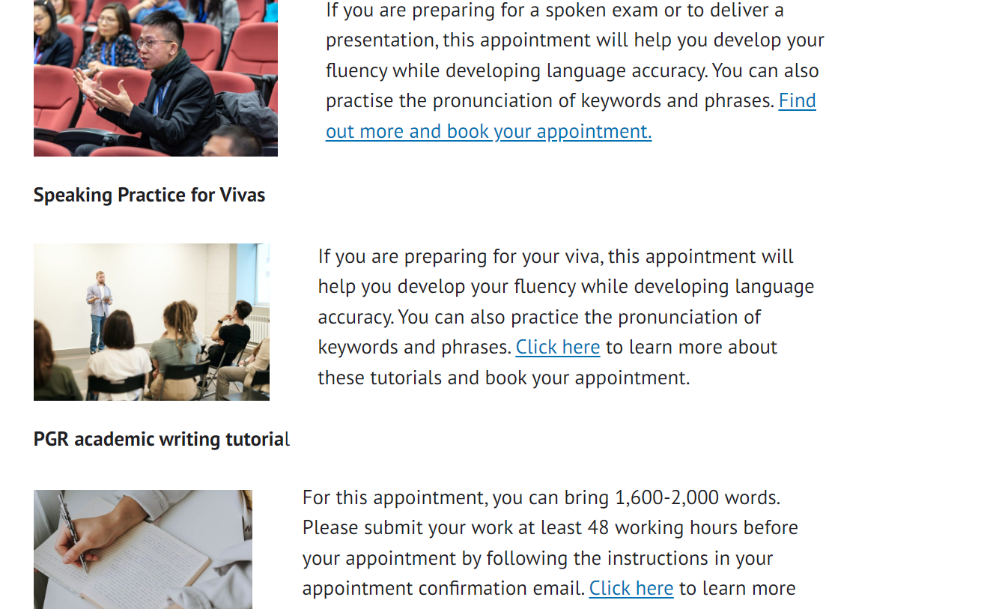
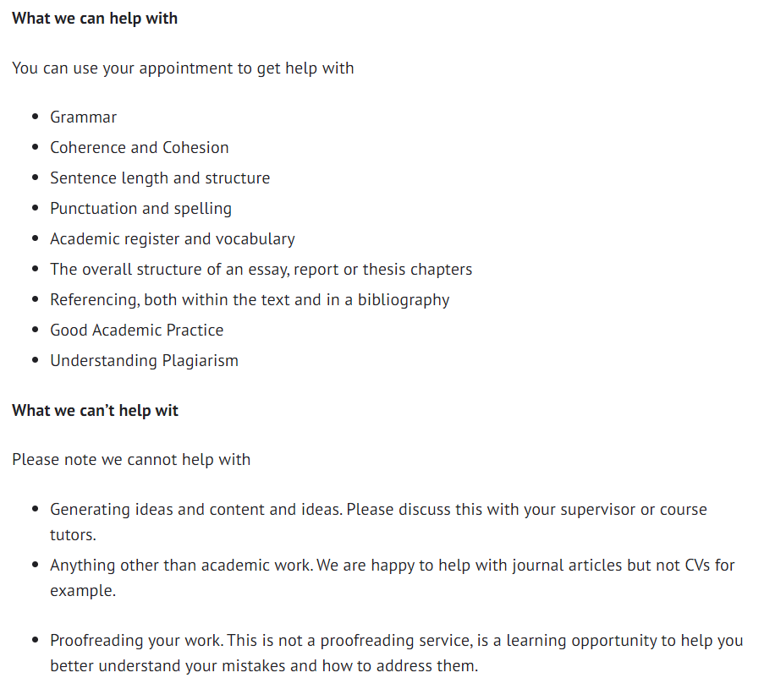
Riding together: Act, assess, adapt
Learner Training
What we can help you with
What we cannot help you with
Monitoring the service
Notes:
Clarity on what we offer, scope of services and what we can and cannot help with
Talk through monitor

Slide 11
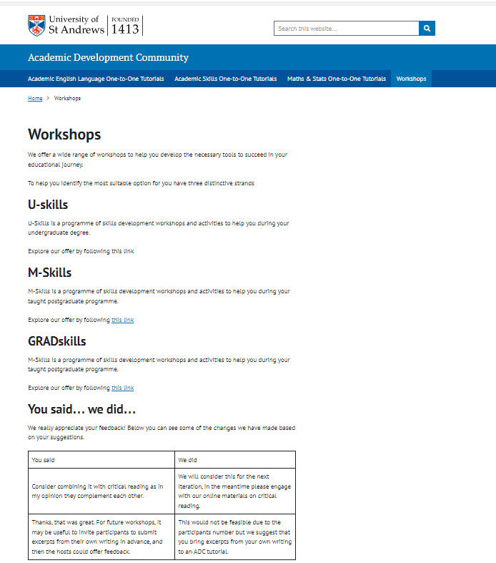
EGAP workshops
Coherent offer
EAP – a focus on linguistic approaches & SFL
All accessible through the same platform
Team teaching – 12 steps to submission!
Notes:
SFL Monbeq, 2019
Belcher 2009

Slide 12
Our learners take
High learner’ satisfaction with one-to-one sessions.
High learners’ satisfaction with the ‘one-stop shop’ website.
High level of satisfaction with tutors.
This does not work for me!
Metacognitive strategies
Content help
They find us through
Direct referrals
Word of mouth
That’s not my name…

Slide 13
Where to now?
All our one-to-one to be under one umbrella
Further alignment with workshops
Development of OL materials
EGAP
ESAP – collaboration with departments

Slide 14
Thanks so much!

Slide 15
References
Belcher, W. L. (2009). Writing your journal article in 12 weeks: a guide to academic publishing success. Sage Publications.
Ding, A., & Bruce, I. (2017). The English for Academic Purposes Practitioner : Operating on the Edge of Academia. Palgrave Macmillan.
Hyland, K. (2021). Teaching and Researching Writing (4th edition). London: Routledge.
Hyland, K. & Jiang, K. (2019). Academic Discourse and Global Publishing: Disciplinary Persuasion in Changing Times. London: Routledge
Monbec, L. (2019) Systemic functional linguistics for the EGAP module: Revisiting the common core, Journal of English for Academic Purposes. DOI: https://doi.org/10.1016/j.jeap.2019.100794

