Slide 1
That thing we don't talk about: Facilitating and assessing student collaborative assignments
Averil Bolster & Peter Levrai
University of Turku (Professional)
University of the Basque Country (Doctoral)
BALEAP Conference, April 2023
Caution! EAP under DEconstruction
University of Warwick

Slide 2
Session Format
Practical issues: ethics and tools
3 short presentations on emergent concepts, followed by small group discussions
Whole group wrap up

Slide 3
Ethics
We’d like to be able to potentially use the Flinga board posts as part of our research.
If you don’t want your discussion group’s comments to be used, please post in grey.
If you would like to participate further in the research project, please complete a consent form at the end of the session.

Slide 4
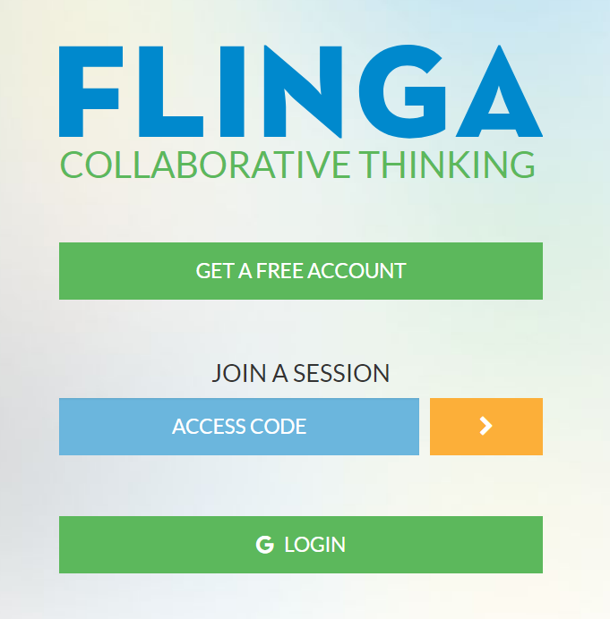
Using ’Flinga’
During the small group discussion, make notes in Flinga, an online response tool.
You can access it via computer or phone.

Slide 5
Using Flinga: Phone
2. Choose the colour to match the question (or grey if you don't want your comments recorded)
Hit “Send”
- a pop-up window appears
3. Write your response
4. Hit “Send”
After clicking send, you can drag your answer to where you want it

Slide 6
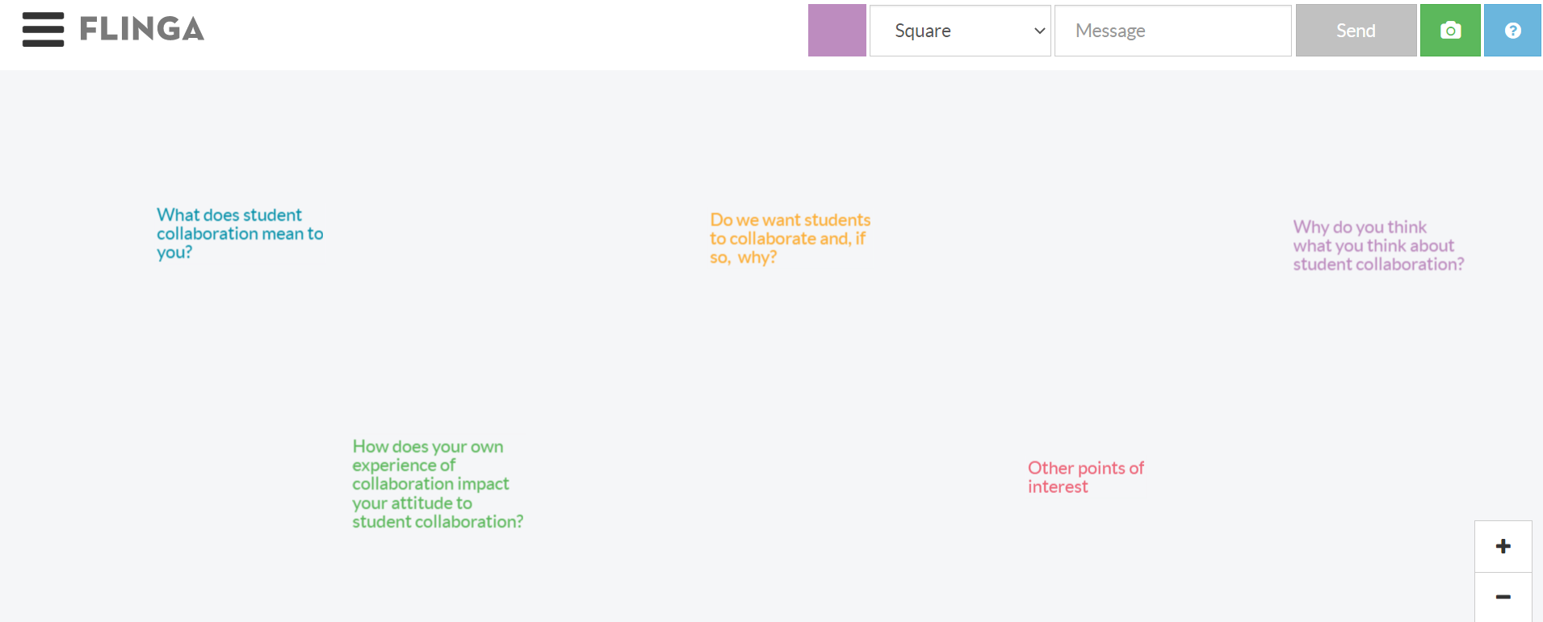
Using Flinga: Computer
Choose the colour to match the question (or choose grey if you don’t want your comments recorded)
Write your response
Hit send
Then you can drag your answer to where you want it

Slide 7
Today’s Session: Student Collaboration
Group essay
Group presentation
Multimedia project
Group discussion
Specifically, collaborative assignments where students work together to produce an artefact e.g.

Slide 8
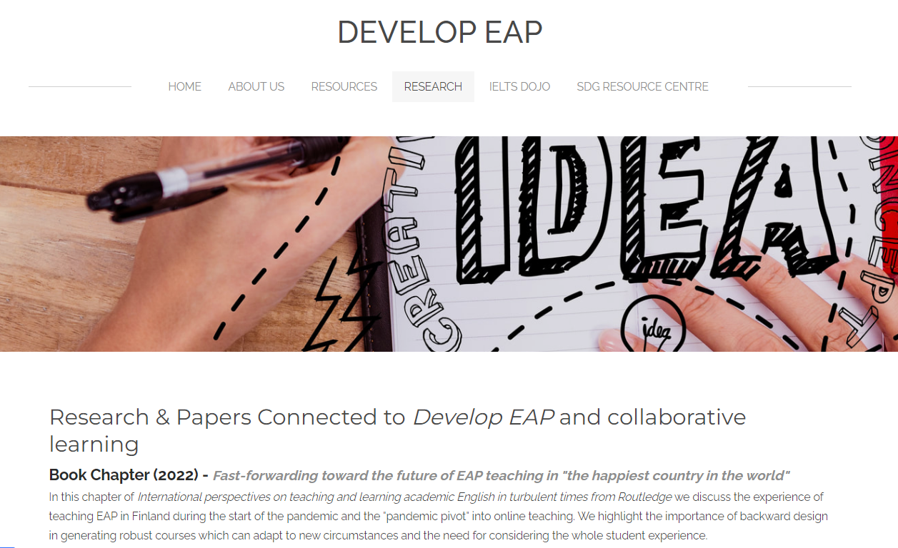
Theoretical Background
We're not going to cover the literature on collaborative learning or assessment today.
Our research and publications about collaboration can be found at:
https://developeap.weebly.com/research.html

Slide 9
Our Research Interests
Following a Grounded Theory approach utilising surveys and in-depth interviews.
31 surveys (to date)
Exploring teacher attitudes and influences in the use (or not) of student collaboration in university courses in English
Towards a framework for assessing collaborative assignments in EAP programmes
16 interviews
(to date)
20 interviews
(to date)

Slide 10
Main areas of discussion
We’ll be sharing early concepts that have emerged from our data to help facilitate discussion in three areas.
Beliefs
Facilitation
Assessment

Slide 11
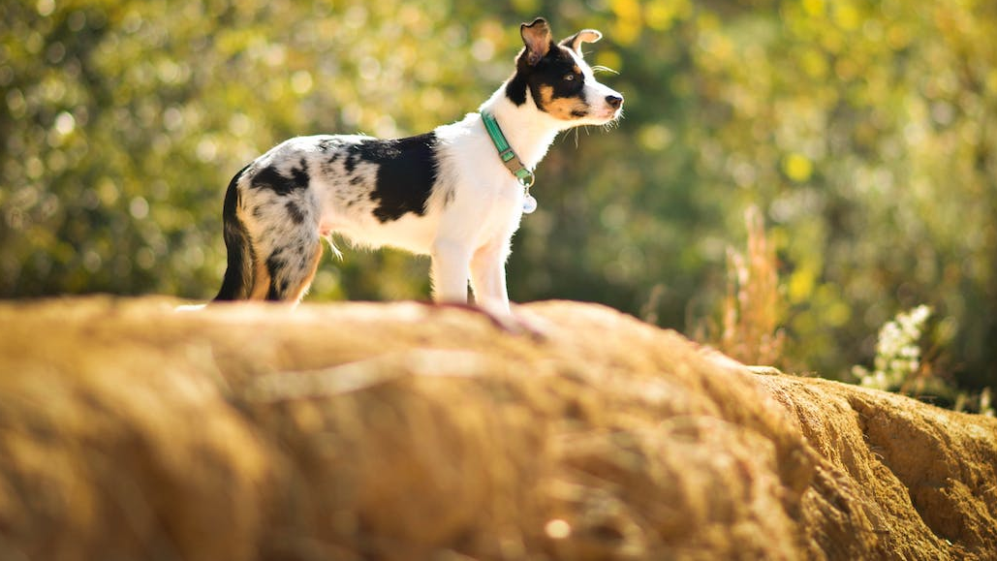
Beliefs about collaboration

Slide 12
Emergent concepts: Beliefs
Collaboration echoes
Personal triggering events of collaboration can have a strong impact on beliefs and teaching practices.
Experience trumps theory
EAP practitioners have limited exposure to training about collaboration, so grow to understand collaboration through their own teaching practice.
Jagged expertise
Experienced ELT/EAP practitioners take pride in their competence and methodologies but have an ‘expertise gap’ when it comes to collaboration.

Slide 13
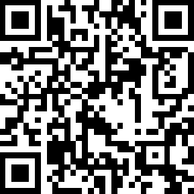
Beliefs
Flinga.fi/FJGHFPF
COLLABORATION ECHOES: Why do you think what you think about student collaboration, i.e. how did your beliefs develop?
EXPERIENCE TRUMPS THEORY: How did you come to learn about student collaboration?
JAGGED EXPERTISE: How confident are you in your knowledge and expertise of student collaboration?
Finish
10 mins

Slide 14
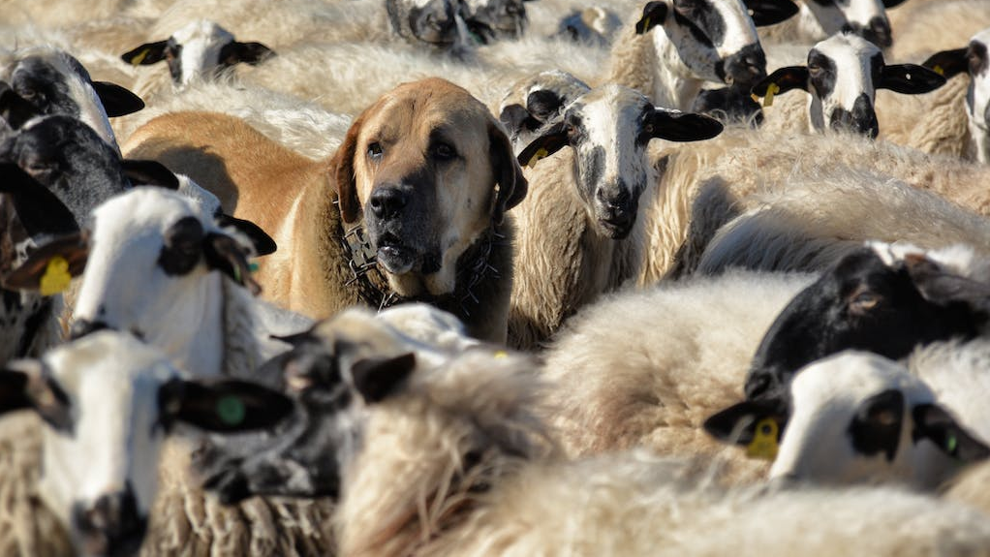
Facilitating collaborative assignments

Slide 15
Emergent concepts: Facilitation
Engagement tribes
Practitioners take very different roles in student collaborations, from the very hands off to functioning as an active group member.
Collaboration foundations
Discussion about collaboration, team roles and working together provides a foundation to help students navigate the process.
Compensating the ‘discipline deficit’
Students will encounter collaborative assignments in their discipline courses but won’t receive scaffolding, so EAP has to prepare them.

Slide 16
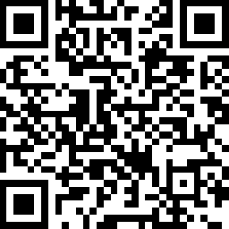
Facilitation
Flinga.fi/F3FCPT9
ENGAGEMENT TRIBES: What is the role of the teacher in a student collaboration?
COLLABORATION FOUNDATIONS: How much do you explicitly talk about collaboration with students?
COMPENSATING THE 'DISCIPLINE DEFICIT': How responsible are EAP courses for developing students' wider academic and soft skills? If not in EAP courses, where?
Finish
10 mins

Slide 17
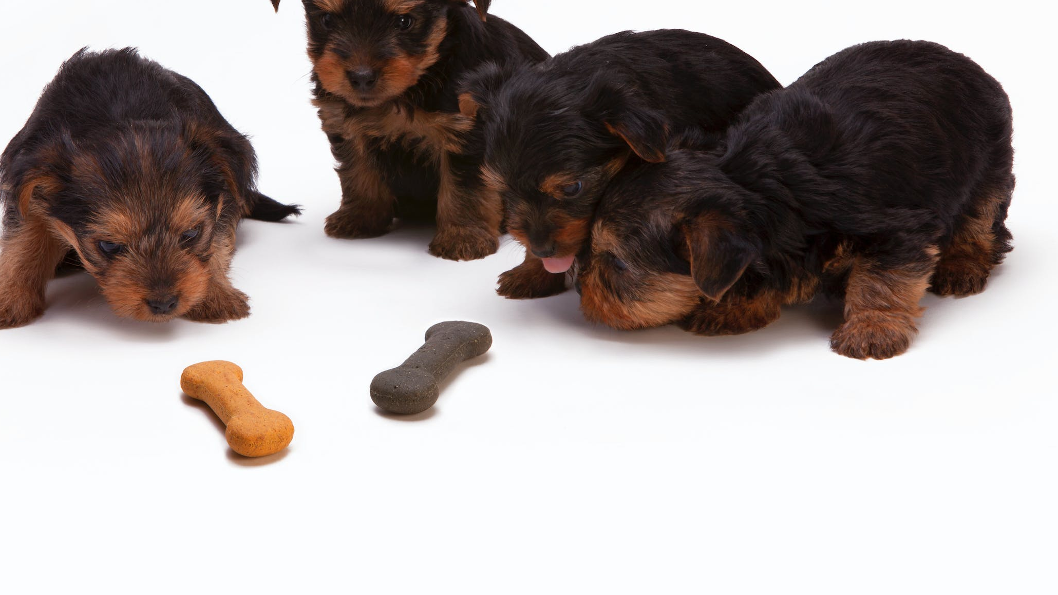
Assessing collaborative assignments

Slide 18
Emergent concepts: Assessment
Multi-lens assessment
Performative collaboration
Specific assessment criteria can lead to students performing superficial collaboration rather than genuinely collaborating.
Assessment of collaboration is complex, requiring a variety of assessment tools (e.g. teacher-group conferences, observation, reflection, self- & peer-assessment)
Task dilution
Learner training for different potential assessment lenses takes time from the main academic task e.g. essay writing.
Notes:
Sweat assessment
In a collaborative assessment, effort is more of a concern than individual assignments to EAP assessors.

Slide 19
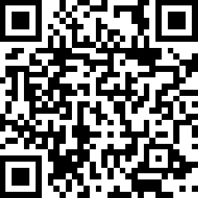
Assessment
Flinga.fi/F4Y56Q9
MULTI-LENS ASSESSMENT: In what ways can student collaboration be assessed?
TASK DILUTION: How much assessment is too much assessment?
PERFORMATIVE COLLABORATION: What do we want to see when students are collaborating?
Finish
10 mins

Slide 20
Wrap-up
We scratched the surface of student collaboration today.
There has to be a lot more community discussion about collaboration.
When you get back to your teaching centres ...
KEEP TALKING

Slide 21
Thank you Questions or comments?
aebols@utu.fi & pflevr@utu.fi
https://developeap.weebly.com
All images from Pexels

