Slide 1
What do we want? Justice! When do we want it? Now! Practitioners demands for a more socially just EAP
Lorraine Mighty – University of Birmingham
Iwona Winiarska-Pringle – University of Glasgow
Wil Hardman – University of Liverpool
EAP for Social Justice SIG (BALEAP)
http://eap4sj.weebly.com/blog.html

Slide 2
Session overview
Introduction – Our approach, ethics and disclaimers
Part 1 – Discussion of ‘provocations’: “experiences, questions, reflections about where EAP as a profession falls short of its ethical obligations”
Part 2 - Practitioner demands: Manifesto for a Socially Just EAP?

Slide 3
Theoretical approach
[The pedagogy of the oppressed] makes oppression and its causes objects of reflection by the oppressed, and from that reflection will come the necessary engagement in the struggle for liberation” p30
“Oppression is domesticating and the only way to emerge from it is through praxis – ‘reflection and action upon the world in order to transform it” p33
(Freire, 1996)

Slide 4
Ethical considerations
Levels of anonymity that can be achieved
Sensitivities of the discussions, and managing distress
Factors that could compromise the confidentiality of the discussions
Inability to ensure the accuracy of the provocations
Implications of these discussions for participants, ourselves as hosts, and the relevant institutions

Slide 5
Ethical approach
Asking people to focus on systems rather than individuals
Editing all details that could identify individuals or cause people to feel minoritized in discussions
Avoiding misrepresentation and censorship as much as possible
Asking people to help to make this a safe space where people feel free to express their views

Slide 6
Discussion – Part 1
What resonated / didn't resonate, and why?
What do you think are the root causes of these unethical practices?
Was anything not mentioned that you feel should be added?

Slide 7
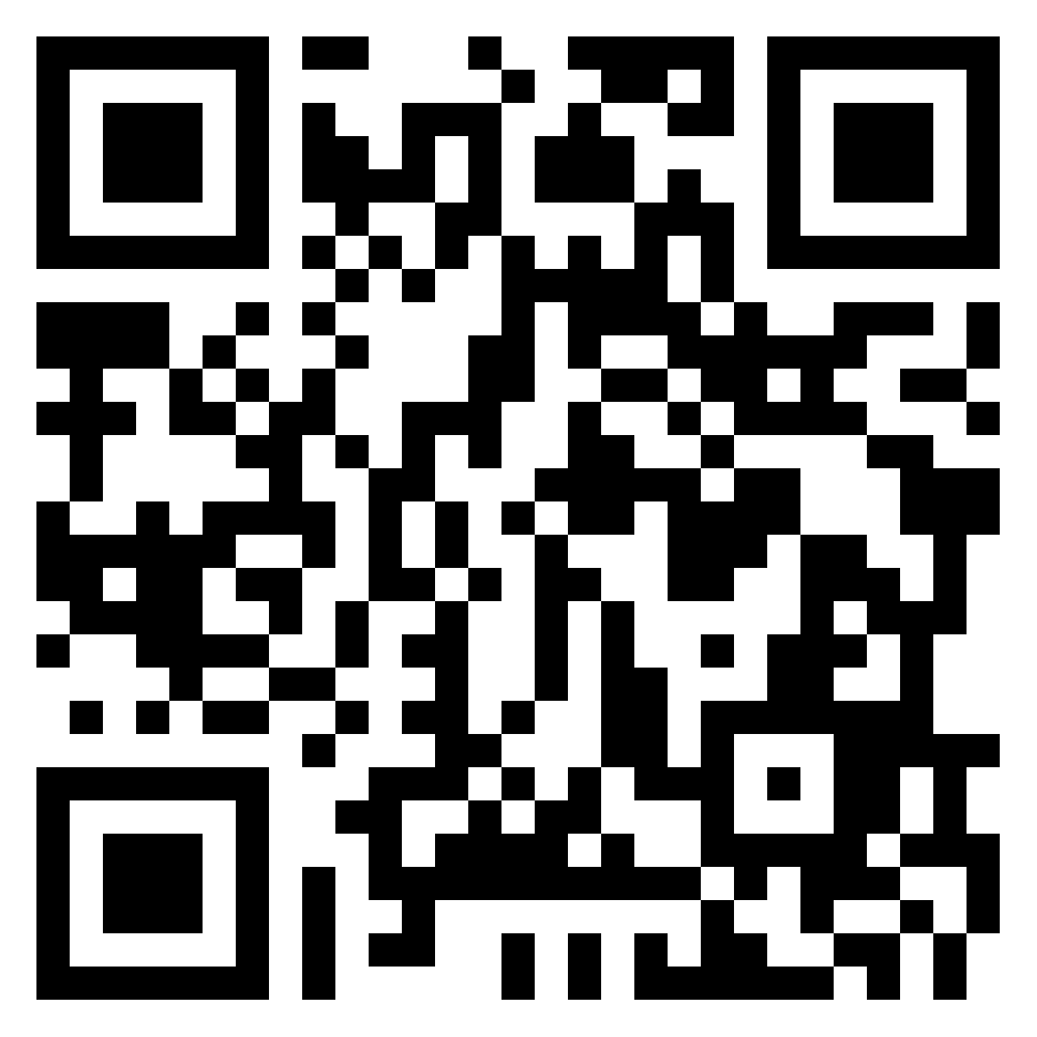
Discussion – Part 2
Choose a theme from the Padlet
Discuss what can be done to challenge these practices at:
individual,
group
institutional/organisational level
3. Add your ideas to the Padlet

Slide 8
Plenary
Key points from the session and the Padlet
Manifesto for a Socially Just EAP?

