Slide 1
BALEAP Biennial Conference 2023
Making the 'case' for a curriculum infusion
linking academic course content to equality diversity and inclusion [EDI] topics.
Vicky Collins and Daniel Devane

Slide 2
Where EDI is embedded in our curriculum and where it isn't...
Outline
The needs of a UG Pre-sessional English cohort and the case study genre
Key topics discussed
in this presentation
Written task design: Identifying an EDI-related theme, a tool for analysis, and developing artefacts
Student realisation of the task and perceptions
Your reflections on embedding EDI into the EAP curriculum

Slide 3
Where is EDI embedded in our curriculum?

Slide 4
Where we felt EDI was addressed..
Modes of delivery are accessible [ online and face to face, with comparable experiences]
Content adheres to best practice for accessibility
Teaching and learning planned to consider the needs of different groups i.e. in setting deadlines and the timing of taught classes.
A range of assessments types and autonomy of choice offered at different junctions
Feedback encourages a reflective approach
Students exposed to a range of culturally challenging views, opinions and contexts through input materials
Students could see themselves reflected in the curriculum [e.g testimonials, assessments where students can draw upon their own background]
Inclusive
OR
Teaching
INCLUSION
TEACHING
Advance HE, 2018

Slide 5
Pre-sessional English programme design
In order to prepare students most effectively for their target academic contexts, the University of Reading PSE Programme design is Genre-informed, integrating:
explicit awareness of the concept ‘genre’ as a framework by which to understand degree-programme writing expectations
awareness of the range of academic genres via which knowledge is constructed and communicated
understanding of how text purpose and audience guides decisions about content, organisation, lexis and syntax
practical understanding of (i.e. experience using) a subset of university genres
development of skills for independent genre analysis which students can utilise in target degree-programme contexts to decode the expectations of tasks and assignments.

Slide 6
Pre-sessional English Undergraduate student cohort [2022]
Other
15%
Degree discipline desinations
Art/Creative Arts
8%
Computer Science
8%
Business & Finance
69%
The approach to EAP
must be highly contexutualised
Materials and tasks are appropriate
to the specified academic context(s)
Baleap, 2022
( BAS Accreditation Handbook)
Notes:
.

Slide 7
Examples of written genres in the specific academic context: business degrees
FINANCIAL ANALYSIS & REPORTS
CASE STUDY REPORTS
ESSAYS OF VARIOUS TYPES
CASE CRITIQUES
PROJECT PROPOSALS
DISSERTATIONS
PSE: cause/effect & exposition/discussion
PSE: a mini research report
Cooper & Bikowski, 2007; Horowitz, 1986 cited in Nathan, 2013

Slide 8
Case report writing
The cases themselves comprise descriptions of company characteristics and actions in specific situations. They are often factually based, incorporating an embedded problem and generally presented in documentary form... Business students respond to these cases in a variety of ways...including case reports.
(Nathan, 2013, p. 58)

Slide 9
to demonstrate/develop an understanding of professional practice through the analysis of a single exemplar
SOCIAL PURPOSE
Case studies
STAGES
description of a particular case, often multifaceted, with recommendations for future actions
Nesi & Gardner, 2012
NETWORKS
typically corresponds to professional genres e.g business, medicine and engineering
EXAMPLES
business start-up, company report, organisation analysis, patient report, single issue
Notes:
.

Slide 10
Assessment
Developing the written assessment task
Instruction
Curriculum
Notes:
.

Slide 11
Analyse a real-world situation or problem and develop recommendations for future action
What situation is meaningful and relevant to the context and the cohort and raises awareness of EDI-related themes?
Use academic knowledge in analysis and problem solving
What business concept or framework would enable analysis?

Slide 12
Analyse a real-world situation or problem and develop recommendations for future action
..... and raises awareness of EDI-related themes?
Use academic knowledge in analysis and problem solving
i.e a business concept or framework that UGs will encounter on their main degree
Employment:
recruitment and selection
SWOT analysis: perspectives of
Ethical, Legal and Business
The university e.g the library?
Gender, race and disability

Slide 13
1.Examine: how ‘Wickham University’, specifically its library, employs new staff.
2.Draw on:
A.Recruitment and Selection Policies and Processes
B.Diversity and Inclusion Principles and Guidelines
C.Case Study Information (5 artefacts)
3.Decide: how well ‘Wickham University’ is meeting diversity and inclusion principles in its processes, including from the following perspectives:
A.Ethical
B.Legal
C.Business
Building the 'case' to analyse
FACT OR FICTION?
both really ..
'factually based'..

Slide 14
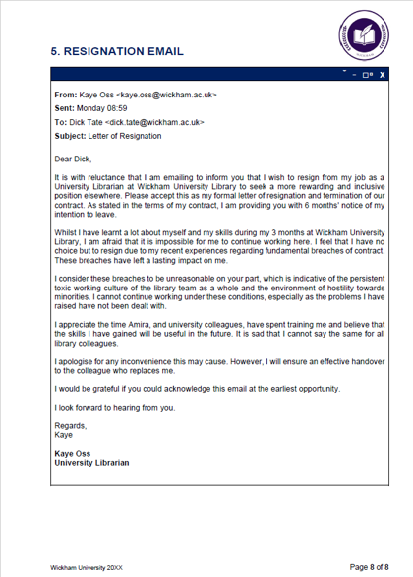
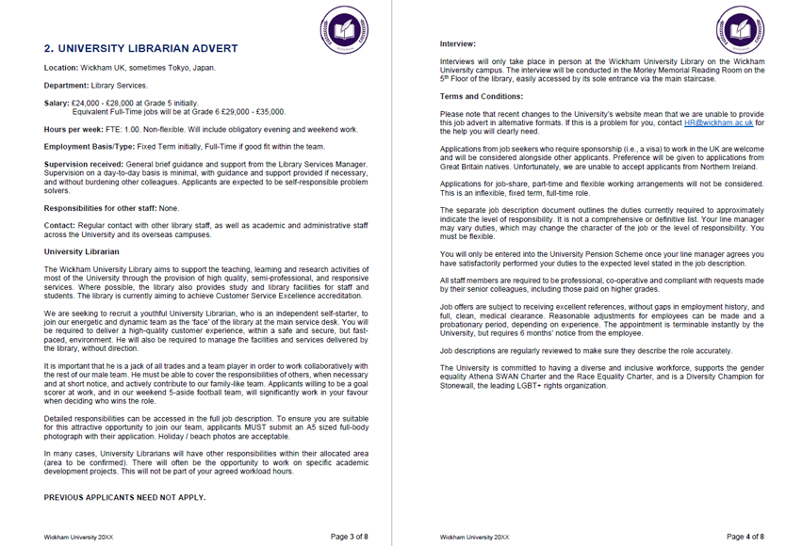
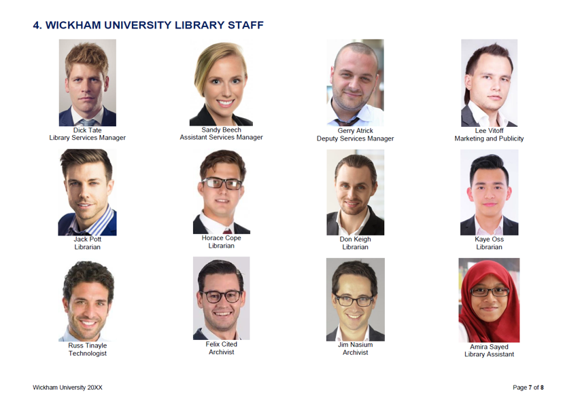
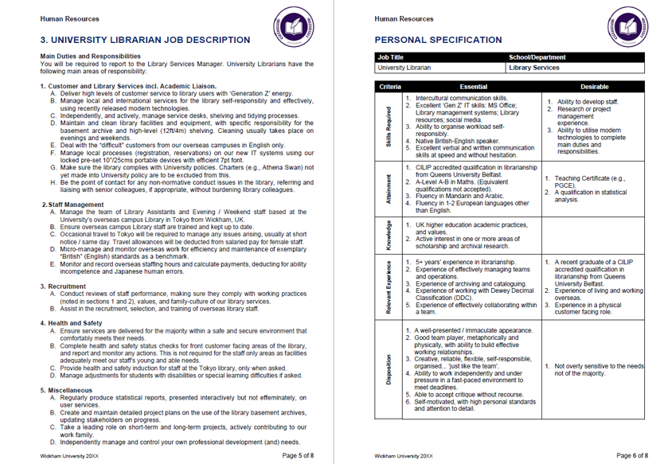
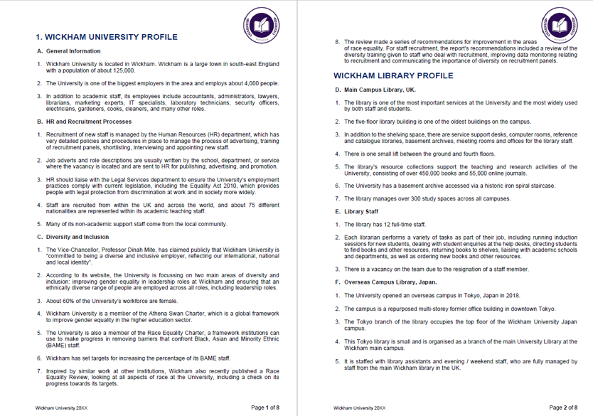
Source material i.e the 5 Artefacts

Slide 15
Applying a SWOT analysis to the case
What Wickham University does well in terms of EDI
What Wickham University does poorly in terms of EDI
The potential for improvement in terms of EDI
Any external factors that may be problematic
...using the artefacts and a synthesis of
reading sources in the course

Slide 16
Final task
Write an individual case study report of 800 words which analyses the recruitment and selection policies of a university. You will need to examine how far the current practices of the university meet equality, diversity and inclusion (EDI) principles by applying a SWOT analysis.
Your report should contain an executive summary, introduction, findings & discussion, and recommendations.
Include your list of references

Slide 17
Measurable Learning Outcomes
LO1 Attribute sources accurately within texts they produce using appropriate in-text and end of text citation methods
LO2 Identify ideas and arguments from academic sources to critically evaluate a real world example or 'case'
LO3 Apply given criteria for analysing a real world example or 'case'
LO4 Use genre-appropriate organisational and linguistic features to complete a written academic Case Study report

Slide 18
Realisation of the task and student perceptions

Slide 19
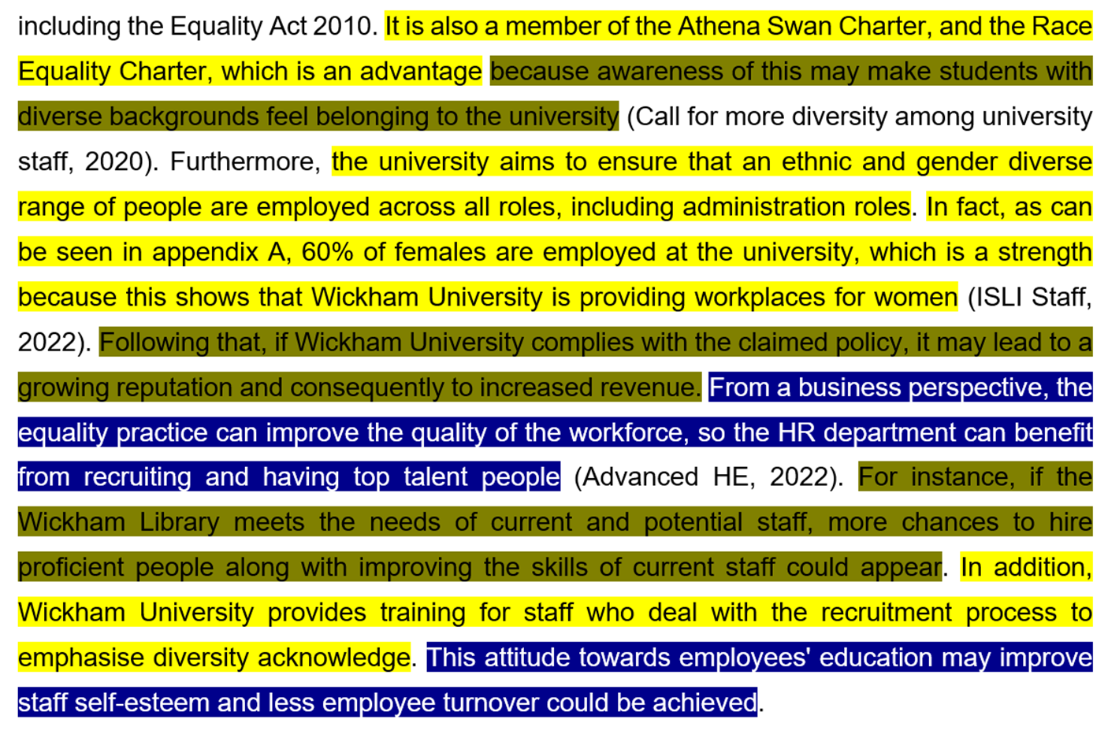
1
2
3
Range: 37 – 81%
Median: 62%
Aide to progression: 85%
Progression rate: 96%

Slide 20
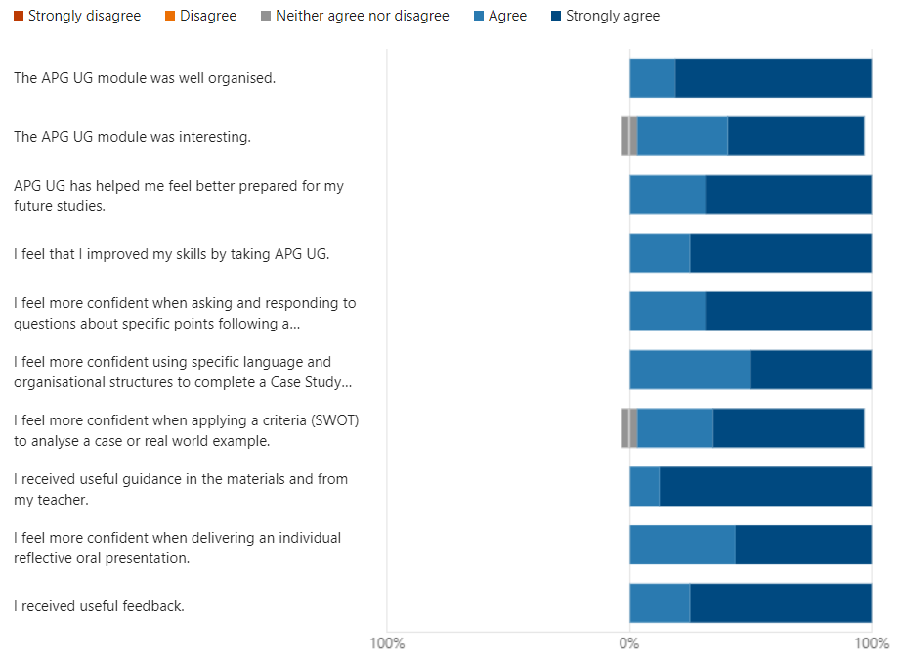
Feedback [1]
Response rate to evaluation survey: 62%
APG = name of module: Academic Practices and Genres

Slide 21
Feedback [2]
What surprised you most about the module?
It taught us to think critically and for us to learn to analyse things for ourselves which I thought was good
I thought the report would be so difficult, but actually we were given a lot of useful information
I thought we would only learn about essays but actually we discovered different types of writing and it was amazing
Learning about report writing, I thought that we would learn about some writing or reading skills

Slide 22
Advance HE. (2018). Embedding equality, diversity and inclusion in the curriculum: A programme standard [Slides]. Advance HE. Retrieved from https://www.advance-he.ac.uk/knowledge-hub/embedding-equality-diversity-and-inclusion-curriculum-programme-standard
References
Baleap. (2022). BAS Accreditation Handbook. Retrieved from https://www.baleap.org/wp-content/uploads/2022/03/BAS-Accreditation-Hbook-v9x.pdf
Nathan, P. (2013). Academic writing in the business school: The genre of the business case report. Journal of English for Academic Purposes, 12, 57-68.
Nesi, H., & Gardner, S. (2012). Genres across the Disciplines. Cambridge

Slide 23
Questions for reflection
Embedding EDI into the EAP curriculum
Notes:
Daniel: transition slide

Slide 24
One of the questions asked about embedding EDI into the curriculum is 'Where do I begin..?' What obstacles and affordances does the EAP curriculum bring?
Can you think of other EAP tasks (written/spoken) which would involve students with concepts around EDI?
Are the expectations of EAP practitioners realistic
in terms of how far we can rethink, and reconstruct curricula to meet wider institutional objectives e.g embedding EDI related topics

