Slide 1
Curiosity and disruption:
what is ‘academic’?
Siân Lund & Sarah Blair
BALEAP23

Slide 2
Curiosity
Disruptive
About ‘academic’
What are our assumptions? How do we categorise it?
Tolerances & how we teach ‘academic writing’
Notes:
We have chosen these themes

Slide 3
Disruption
The text
Text as static structure - outcome
Identify the features but understand a process
Text for exploration
The Practice
How was ‘the writing’ achieved?
Practice of meaning-making

Slide 4
Curiosity & the Text
…the nature of disciplinary knowledge
(Clarence & McKenna 2017)
An overt focus on texts as social practices, situated within value-laden, idealogially-shaped contexts
…a focus on the structure of knowledge
Notes:
What does the text tell us?
Looking at the text to discover the social practice: how it was shaped -
structure of knowledge, not structure of a text

Slide 5
Participation as Disruption
Participatory learning (Lave and Wenger 1991)
Social communities
(Wenger 2000)
situated negotiation and renegotiation of meaning in the world
identity transformation is an integral part of the learning process
Knowing…displaying competences defined in social communities
Notes:
Wenger 2000 social learning systems - participatory learning as a process which is ‘based on
learner: subjective component…
Learner understands the practice of participation: of negotiation, transformation as the learning process, not learning a structure

Slide 6
Disruption
A sticky curriculum (Orr & Shreeve 2018)
pedagogies are uncomfortable and destabilising but necessary … procedural knowledge in art and design disciplines may be obscure or hard to write down and codify
Notes:
Tolerance of ambiguity - need to ‘travel’, need to ‘do’ something, not follow a formular/\
Art and Design: formation of knowledge might be especially
not the ontology of what it is

Slide 7
Disruptive Process
Embodied, embedded & embrained knowledge
(Blacker 1995)
Embodied, embedded & embrained knowledge.
(Knowing) is analyzed as an active process that is mediated, situated, provisional, pragmatic and contested.

Slide 8
An Active Process
Skill/Practice distinction: an epistemological approach (Molinari 2022)
learning how to compose a paragraph (a skill…) is not the same as understanding the ‘intellectual work’ that paragraphs do…
A skills-based approach becomes problematic because, for example, it remains silent on the more elusive academic practice of developing an ‘academic voice’ (Elbow, 1994; Matsuda & Tardy, 2008) or on cultivating an awareness of readership (audience) (Richardson, 1990b).
https://www.bloomsburycollections.com/book/what-makes-writing-academic-rethinking-theory-for-practice/ch1-troubling-academic-writing-problems-and-implications-for-higher-education
Notes:
https://www.bloomsburycollections.com/book/what-makes-writing-academic-rethinking-theory-for-practice/ch1-troubling-academic-writing-problems-and-implications-for-higher-education
such as being impersonal or having paragraphs. There is no such thing as a ‘standard’ academic essay because there are several kinds.
if writing is understood for the epistemological work that it does, it becomes easier to recognize that it will vary in its forms according to its purposes.
How can [students] adapt their literacy practices to meet the requirements of their discipline or field of study?
(Clarence & Mckenna 2017)

Slide 9
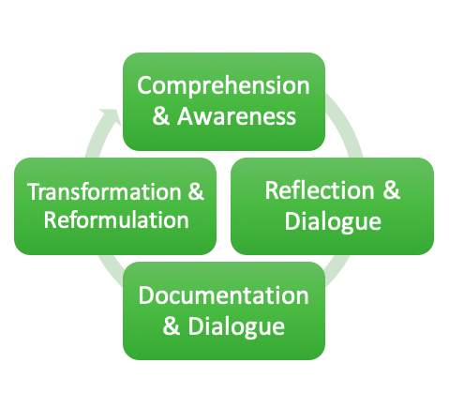
Process of Enquiry
Situated negotiation and renegotiation of meaning (Lave and Wenger 1991)

Slide 10
Cognitive Processes as Practice
Eval-
uation
Review: strength, inconsistencies, position
Synthesis
commitment, position, ‘narrative’: voice
Analysis
deconstruct views/bias etc., reflect, , integrate, prioritise, value
Application
change contexts, employ in context: implement
Comprehension
clarify, paraphrase, examples,catergorise, compare, contrast
Knowledge
identify, retrieve, locate
Bloom’s Taxonomy

Slide 11
Writing as Practice

Slide 12
Selected references
Austerlitz et al. (2008), ‘Mind the Gap : expectations, ambiguity and pedagogy within art and design higher education.’ In: Drew, L. (ed) The Student Experience in Art and Design Higher Education : Drivers for Change. Jill Rogers Associates Limited, Cambridge.
Bernstein, B. & Solomon, J. (1999) 'Pedagogy, Identity and the Construction of a Theory of Symbolic Control': Basil Bernstein questioned by Joseph Solomon, British Journal of Sociology of Education, 20:2, 265-279,
Blackler, F. (1995) ‘Knowledge, Knowledge Work and Organizations: An Overview and Interpretation.’ Organization Studies, 16(6), 1021–1046
Clarence, S. and McKenna, S. (2017) ‘Developing academic literacies through understanding the nature of disciplinary knowledge’ London Review of Education, 15, 1.
Donszelmann, B. Hatton, Kate (Ed.) (2015) Towards an Inclusive Arts Education, Institute of Education Press, 2015
Gray, C. and Malins, J. (2004) ‘The Reflective Practitioner’ in Visualizing Research: A Guide to the Research Process in Art and Design. England: Ashgate Publishing Limited
Lea, M. R. & Street, B. V. (2006) ‘The "Academic Literacies" Model: Theory and Applications’, Theory Into Practice, 45:4, 368-377
Lave, J., & Wenger, E. (1991). Situated learning: Legitimate peripheral participation. Cambridge University Press.
Martin, J. R. and Rose, D. (2008). Genre Relations: Mapping Culture. London: Equinox.
Orr, S. (2020) ‘Assessment and Attainment in Art and Design Education: Dr Emily Salines Interviews Professor Susan Orr.’ The Exchange, UAL [online] Vimeo Available from : https://vimeo.com/458640666
Orr, S. and Shreeve, A. (2018), Art and Design Pedagogy in Higher Education: Knowledge, Values and Ambiguity in the Creative Curriculum, OXON: Routledge.
Molinari, J. (2022) What Makes Writing Academic Rethinking Theory for Practice, Bloomsbury Academic 2022
Swales, J. (2014) ‘Genre and Discourse Community’ In Angermuller, J. Maingueneau, D and Wodak, R (eds.) The Discourse Studies Reader: main currents in theory and analysis. Amsterdam:John Benjamins, pp. 305-318
Thomas and May (2010) Inclusive Learning & Teaching in Higher Education – HEA final report
Wenger, E. (2000) Communities of Practice and Social Learning Systems, SAGE, 7(2)
Notes:
Clarence, S. and McKenna, S. (2017) ‘Developing academic literacies through understanding the
nature of disciplinary knowledge’ London Review of Education, 15, 1.

