Slide 1
Inclusivity, interactivity and communities of practice: exploring principles of an instructional design in a post-pandemic online programme in English for academic study Dr Weronika Fernando Queen Mary, University of London
Update (1) BALEAP
Caution! EAP Under DEconstruction
University of Warwick
19-21 April 2023

Slide 2
Online programme in English for academic study
Pre-sessional provision
12-week programme, starting as EGAP and progressing to ESAP (light)
Necessitated by Covid-19 pandemic
Hosted on QMUL’s VLE
Moodle branded as Mahara branded as
Higher student satisfaction than f2f provision
700+ students at peak / 400+ in 2022
Key considerations in materials migration:
Creating stimulating and transformative learning environments by:
taking account of student diversity (Scarino 2022),
promoting multi-channel interactions (Moorhouse and Walsh 2021),
and offering context-specific learning experiences (Atabekova, Lutskovskaia and Gorbatenko 2021).

Slide 3
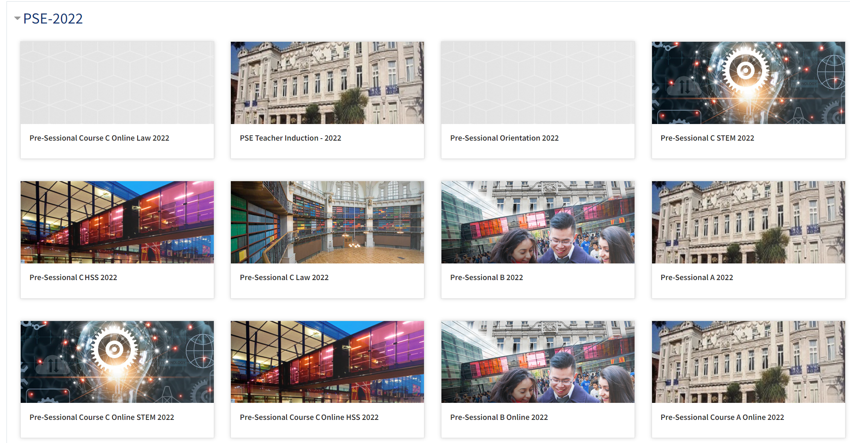

Slide 4
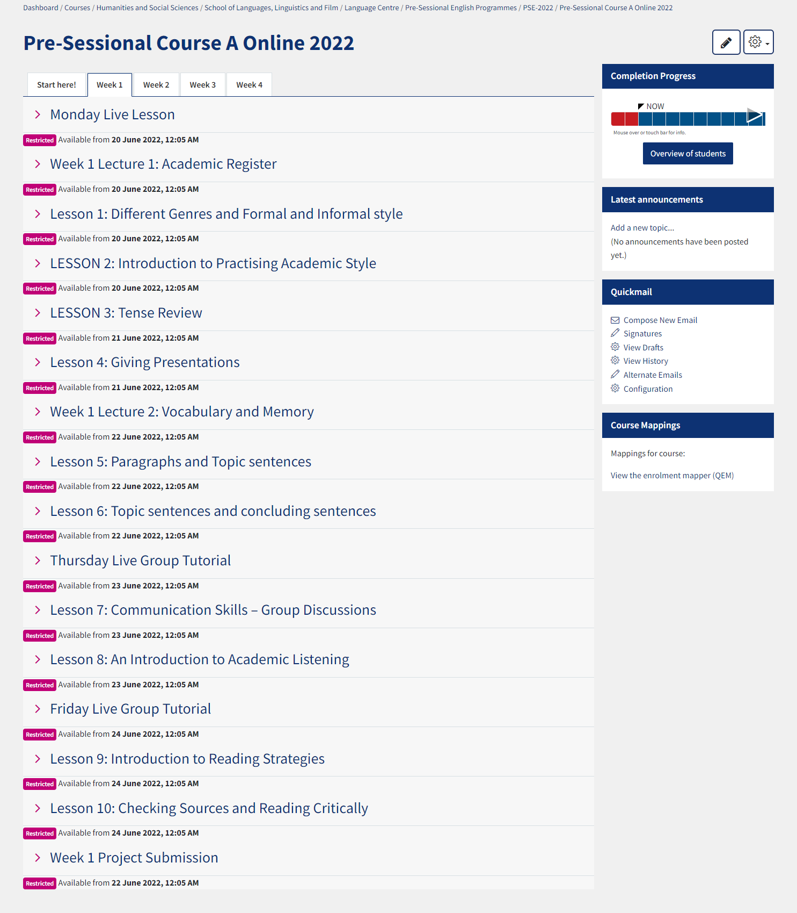

Slide 5
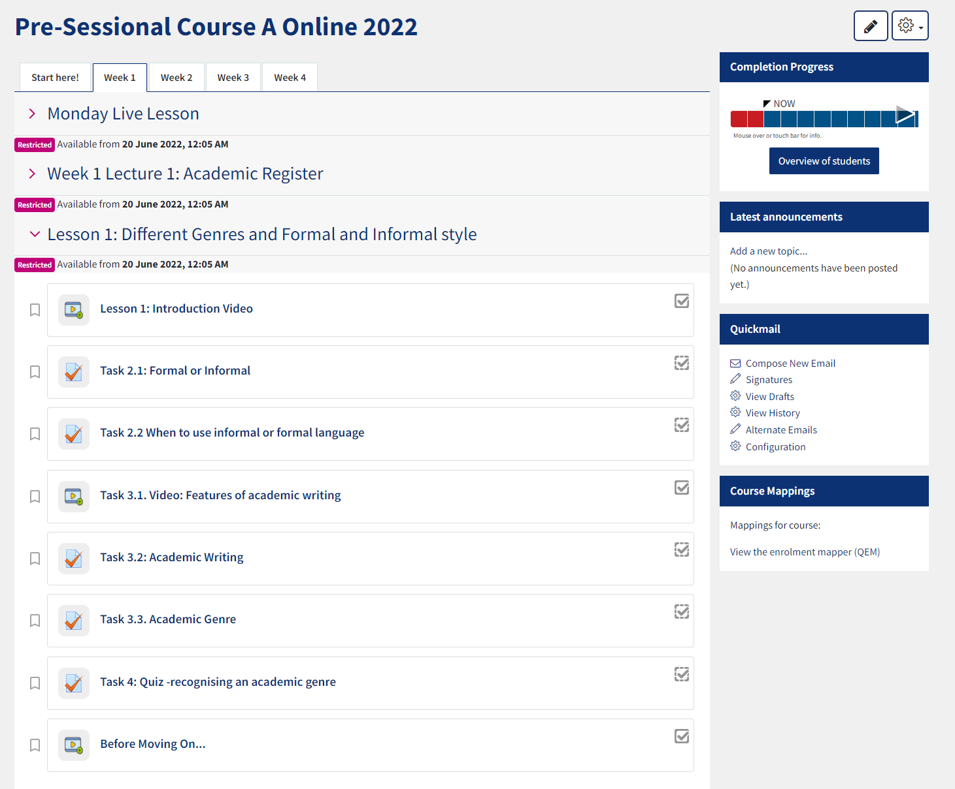
https://qmplus.qmul.ac.uk/course/view.php?id=19131

Slide 6
Research Questions
Main RQ: What are the features of an EAP instructional design that takes account of inclusivity, interactivity and student participation in their respective communities of practice?
Subsidiary RQs:
What are the features of an online EAP programme that is inclusive of a variety of students’ needs and sensitive to their cultures and backgrounds?
What online tools are helpful in creating an interactive learning environment?
To what extent an online instructional design can lend itself to supporting student learning of the discourse(s) of their target communities of practice?

Slide 7
Data Sets
Online platform materials
Cross-sectional collection of materials
Check-list approach
Students
Survey (oe/ce)
Semi-structured interviews
EAP practitioners /materials designers
Semi-structured interviews

Slide 8
Project timeline
Online platform materials
Cross-sectional analysis
By Nov 2022
Nearing completion now
Students
Survey
Jan 2023
April - May 2023
Interviews
April – June 2023
May - July 2023
EAP practitioners / materials designers
Interviews
April – June 2023
May – July 2023

Slide 9
Expected outputs
Report with recommendations for an online programme design
Early Autumn2023
Multimodal narrative reflecting on the key findings from the study (BALEAP website)
Early Autumn 2023
Talk / workshop in collaboration with a BALEAP SIG
Winter 2023/24
JEAP article
Summer 2024

Slide 10
Selected References
Atabekova, A., Lutskovskaia, L., & Gorbatenko, R. (2021). Developing multiliteracy skills and pragmatic communication awareness of university students learning a foreign language (English) for specific purposes. Thinking Skills and Creativity, 42, 100956.
Chapelle, C. (2001). Computer applications in second language acquisition: Foundations
for teaching, testing, and research. Cambridge: Cambridge University Press.
Chapelle, C. (2007). Challenges in evaluation of innovation: Observations from technology research. International Journal of Innovation in Language Learning and Teaching, 1(1), 30-45.
Croxton, R. A. (2014). The role of interactivity in student satisfaction and persistence in online learning. Journal of Online Learning and Teaching, 10(2), 314.
Fereday, J., & Muir-Cochrane, E. (2006). Demonstrating Rigor Using Thematic Analysis: A Hybrid Approach of Inductive and Deductive Coding and Theme Development. International Journal of Qualitative Methods, 5(1), 80–92.
Gee, J. (2015). Social linguistics and literacies: Ideology in discourses. London/New York: Routledge.
Green, J., & Bloome, D. (2004). Ethnography and ethnographers of and in education: A situated perspective. Handbook of research on teaching literacy through the communicative and visual arts, 181-202.
Hodges Ch., Moore, S., Lockee T. T., Bond, A. (2020) The difference between Emergency Remote Teaching and Online Learning. Educausereview, accessed: 08 Nov 2020, https://er.educause.edu/articles/2020/3/the-difference-between-emergency-remote-teaching-and-online-learning¬¬
Hamp-Lyons, L., & Hyland, K. (2002). EAP: Issues and directions. Journal of English for Academic Purposes, 1(1), 1-12.
Hyland, K. (2002). Specificity revisited: How far should we go now?. English for Specific Purposes, 21(4), 385-395.
Maguire, M. (2019). Equality and justice in education policy. Journal of Education Policy, 34(3), 299-301.
Moorhouse, B. L., Li, Y., & Walsh, S. (2021). E-classroom interactional competencies: Mediating and assisting language learning during synchronous online lessons. RELC Journal, 0033688220985274.¬¬¬¬
Moore, M. G. (1989). Editorial: Three types of interaction. The American Journal of Distance Education, 3(2), 1–7.
Lea, M. R., & Street, B. V. (1998). Student writing in higher education: An academic literacies approach. Studies in Higher Education, 23(2), 157-172.
Li, L. C., Grimshaw, J. M., Nielsen, C., Judd, M., Coyte, P. C., & Graham, I. D. (2009). Evolution of Wenger's concept of community of practice. Implementation science, 4(1), 1-8.
Lillis, T., & Scott, M. (2007). Defining academic literacies research: Issues of epistemology, ideology and strategy. Journal of Applied Linguistics, 4(1), 5-32.
Saldaña, J. (2021). The coding manual for qualitative researchers. London: Sage.
Scarino, A. (2022). Language teacher education in diversity–a consideration of the mediating role of languages and cultures in student learning. Language and Education, 36(2), 152-169.
Stentiford, L., & Koutsouris, G. (2021). What are inclusive pedagogies in higher education? A systematic scoping review. Studies in Higher Education, 46(11), 2245-2261.
Stevens, G. J., Bienz, T., Wali, N., Condie, J., & Schismenos, S. (2021). Online university education is the new normal: but is face-to-face better?. Interactive Technology and Smart Education , 18(3), 278-297.
Thomas, D. R. (2006). A General Inductive Approach for Analyzing Qualitative Evaluation Data. American Journal of Evaluation, 27(2), 237–246.
Thomas, M., Reinders, H., & Warschauer, M. (2014). Contemporary computer-assisted language learning: The role of digital media and incremental change. In Thomas, M., Reinders, H., & Warschauer, M. (eds), Contemporary computer-assisted language learning, London: Bloomsbury,1-18.
Yarmand, M., Solyst, J., Klemmer, S., & Weibel, N. (2021). “It Feels Like I am Talking into a Void”: Understanding Interaction Gaps in Synchronous Online Classrooms. In Proceedings of the 2021 CHI Conference on Human Factors in Computing Systems (pp. 1-9).
Wingate, U. (2015). Academic literacy and student diversity: the case for inclusive practice. London: Multilingual Matters.

