Slide 1
Pre-sessional Teacher Induction: Winning Hearts and Minds
Diana Scott
Durham Centre for Academic Development

Slide 2
Overview
Setting out the problem
- what can we anticipate?
Induction as the solution
- 5 principles for Induction design & delivery
Live issues

Slide 3
When you say Pre-sessional…
Design
Delivery
IELTs?
EAP?
ESAP?
Four Skills?
Weighted Skills?
Integrated Skills?
Study Skills?
Grammar & Language focussed?
Product, process & academic culture focussed?
Preparation for UG?
Preparation for PG?
Flipped?
Blended?
Live?
Digital?
Luddite?
Teacher + classroom only?
Plus Mass EAP/ESAP?
Bought in curriculum?
In-house curriculum?
Skeletal curriculum?

Slide 4
The unfettered ideal?

Slide 5
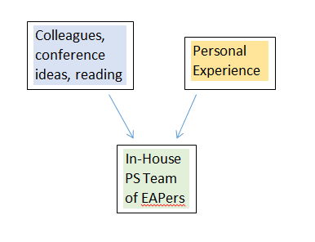
Layer 1: local constraints…
Your Centre / Unit / Department
Contracts
Workload models
Remits

Slide 6
Layer 2: local constraints …
Relationships, power structures and practicalities within your university
Faculty
Support Services
International Office
Other academic departments
The PVCs (Education, Global etc.)
Immigration staffing
Library staffing
Term Dates
Facilities
Admissions
Student recruitment / market

Slide 7
And of course layer 3…
UKVI’s latest _________

Slide 8
So your pre-sessional...
…is not my pre-sessional.

Slide 9
But our pre-sessional teachers are often from the same external pool

Slide 10
When you say pre-sessional teacher…

Slide 11
Not only do external staff have little reason to anticipate or appreciate your constraints…

Slide 12
…but they are on pre-sessional for different reasons with different wants
Testing the water of EAP?
Professionalising / hoping to use PS as CPD and a stepping stone?
Doing what they enjoy with no strings attached?
Cobbling together a year’s worth of short contract work and earnings?

Slide 13
And what do we want?
At Durham…
~700 PGT students and ~100 UG students to get comparable teaching and learning experiences in terms of:
- Input
- Quality
- Timing
- Messages
~800 students to pass the assessments we have designed on the basis of our curriculum
~800 potential future In-sessional students to continue their academic development with us with a shared foundation

Slide 14
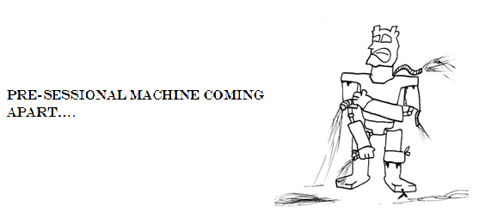
Potential consequences
Teacher comment: Based on my X years of successful experience at Y, I think you should make the following changes and communicate them next week…
Student delegation: we want to change teacher b/c…
Teacher comment: I don’t really know what my partner teacher / marker thinks, I hardly know them…
Student complaint: this course isn’t relevant to me, my teacher agrees!
2nd marker query: this class has clearly been advised differently, do I still mark them down?

Slide 15
What we need therefore is…
An act of mutual empathy
- justification for & value of our pre-sessional
- recognition of potential value of alternatives
Early unanimous investment in common goals
Rapid familiarity with and understanding of our course
How?
INDUCTION: win hearts and minds!

Slide 16
Common Induction Pitfalls?
Housekeeping and logistics bombardment
A hotchpotch of sessions
Lazy delivery

Slide 17
Principle No.1
Provide insight into your course rationale…
- where are we going?
- how are we getting there?
- why?
e.g. explore our underlying EAP principles / beliefs / understandings
e.g. unpick our local context
e.g. show the kind of work students produce each year
e.g. look at how PS fits into the rest of the EAP/ESAP provision coming out of our department
Benefits:
- Enhance teachers’ institutional knowledge & sense of belonging
- Mitigate teacher expectations / desires for PS to fulfil a one-stop-shop ideal
- CPD: from thinking like a teacher to thinking like a manager

Slide 18
Principle No.2
Create space for teachers’ voices and thinking…
- assumptions, expectations, knowledge, alternative ideas
e.g.
“describe your ideal PS course”
“list all the text types and assignment types this cohort of students are going to need to work with on their degrees”
Benefits
recognise the experience / knowledge / intelligence in the room
discover people’s starting points and know better the distance you need each to travel
create a forum to both acknowledge and explicitly set aside perspectives that do not align with your PS

Slide 19
Principle No.3
Approach your induction sessions as a teacher, consider:
- attention span
- engagement / motivation
- uptake of information
- diversity of experience in the room
- room management
- facilitating relationship building
e.g. do your prep, set-up your room, learn names, plan your groupings, know your takeaways, set homework etc.
Benefits
- model good practice
- earn credibility
- build relationships between people you know will share a part of
campus / share classes / share marking
- set up links between the experienced and inexperienced

Slide 20
Principle No. 4
Don’t just timetable it, curriculum it! Make sure…
- someone has oversight and knowledge of all the induction sessions, what they cover, and how they interrelate
- your induction session deliverers understand how they fit in the chain
e.g. consider
- recycling, recapping, ‘bang for buck’
- redundancy, contradictions
- necessary prior knowledge
- opportunities to pre-empt the first week’s teaching
Benefits:
Obvs!

Slide 21
Principle No. 5
Your CPD should serve your course and your students, not just your teachers
- bolt-on CPD sessions risk diluting the course and its delivery
- the more work you are able to put into the course the more CPD can arise out of the course
e.g. regular curriculum meetings can sustain the culture set at induction and thus further professional insight into your curriculum which is developmental
If you don’t have time to offer more, seek low-labour ways to enhance your teachers’ institutional knowledge
get your In-sessional team to offer something
get your Disability Support or Counselling team to offer something

Slide 22
Nice ideas but…
Can you secure enough paid induction time for you and your teachers?
What if circumstances have not allowed you off-season time to really develop your curriculum and rationale as you would like?
How do you handle variations on the ratio of in-house staff to external staff, of returnees to newbies?

