Slide 1
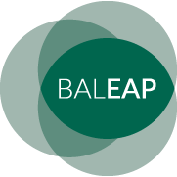
BALEAP 2019
Dr. Paul Breen
University of Westminster
Reshaping activity &
pedagogy in EAP &
Academic Practice

Slide 2
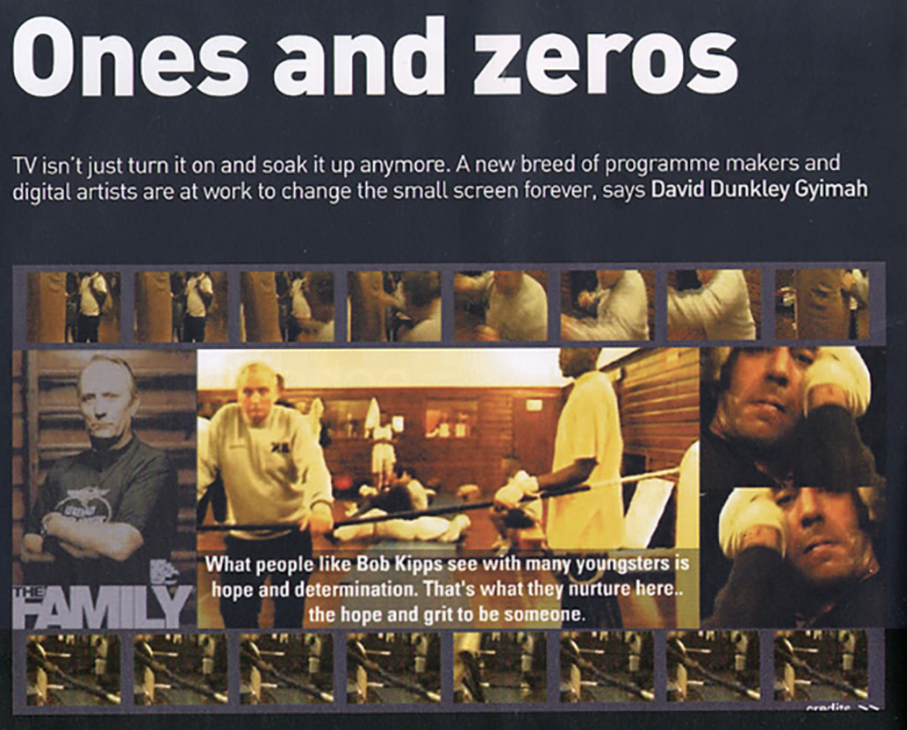
HE context

Slide 4
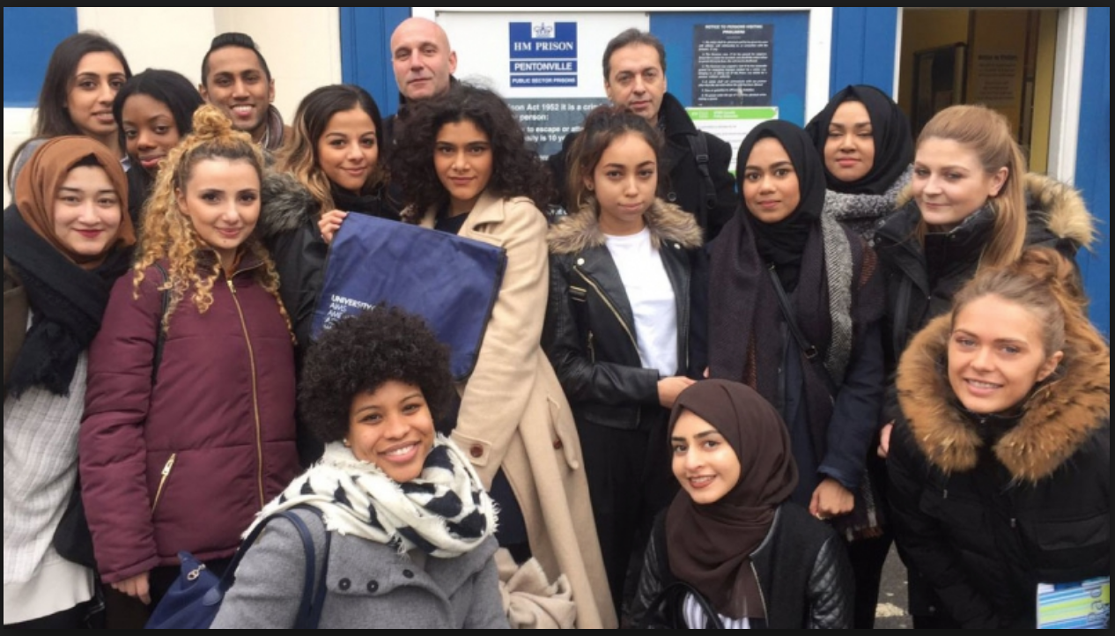

Slide 6
Questions???
What do students want?
Is that different to what they need?
How do these wants and needs impact on our activity in the classroom/our pedagogy?
What contribution, if any, can the student voice make to the reshaping of our activity?
How do we use that staying focused on the core activity of EAP teaching/academic literacy?

Slide 7
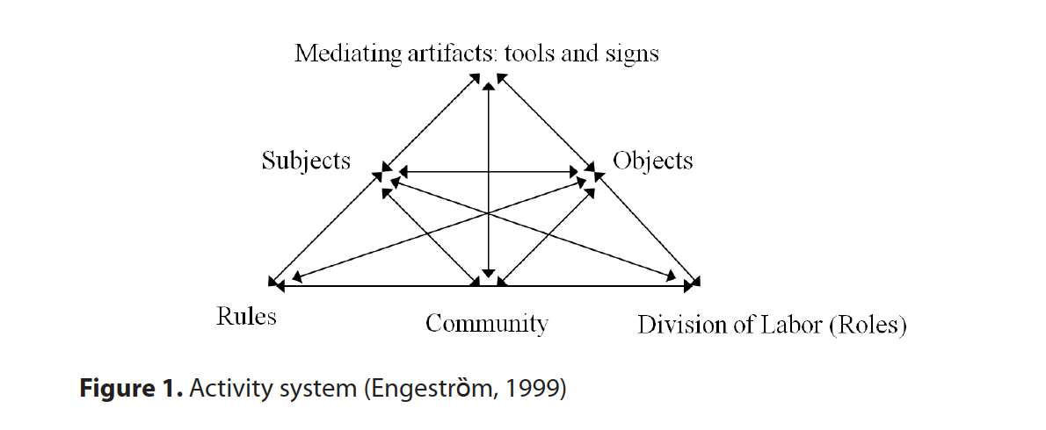
Activity theory - Sociocultural theory of how activity is shaped as a consequence of interaction between different variables, particularly in light of how transformation comes about - Engeström (1999).

Slide 8
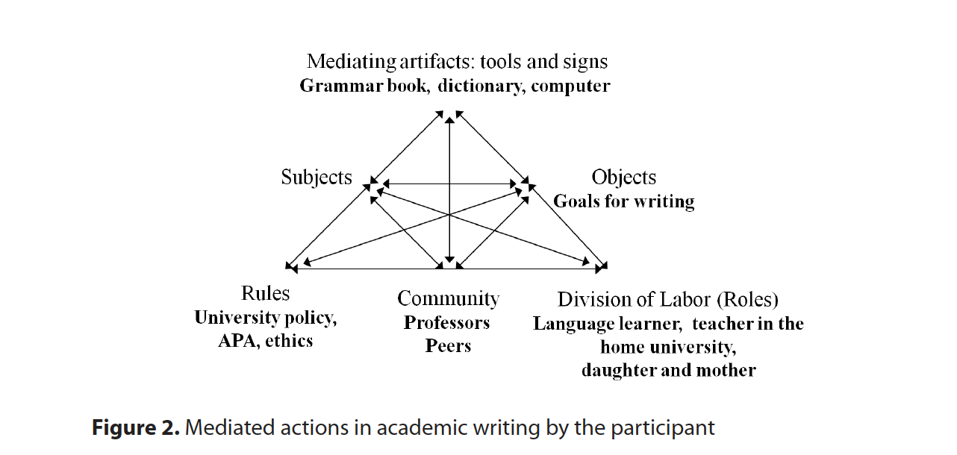
Increasing usage & adaptation in language-based contexts e.g. - Park & De Costa (2015).

Slide 9
Research
Surveys given out to two groups of students I was teaching.
Ideally three, but didn’t materialise.
One on a Foundation Programme that included home students (100+).
The other on an autumn Pre Sessional course – all international and mostly postgrads (40+) – course described in Essex.

Slide 10
TYPES OF QUESTIONS – 10 IN TOTAL
Definition of real world activity/real world engagement in the disciplines
Start with usual demographic questions – nationality, discipline etc
Asked about relevance of studies to disciplines and the everyday world
Previous experiences of this kind of engagement, developments as a result
Preferences for the kinds of engagement they wanted to see and why they felt that these might benefit them

Slide 11
Responses
Basic summary – Though both sets of students do want their studies to have a real world + disciplinary connection and even impact, ‘home’ students are more likely to prioritise this than international.
International students appear to have a greater sense of the need to find synergy between skills (academic literacies) & disciplinary linkage.

Slide 12
Responses
Basic summary – Both groups of students suggested that activities outside the classroom gave impetus for the development of skills.
A Portuguese student of Chinese & Global Communications – museum trips “encouraged language and writing skills, extra reading for research.”

Slide 13
Sample response
One Chinese student stated that “academic ability, particularly academic writing” is important but having work experience in her disciplinary area of Museum Management she feels that in professional practice “the real world outweighs theory.”
In her case she saw “volunteer work experience” as being most critical to her studies.

Slide 14
More responses
A demand for “guest speakers” – Japanese student.
“Engage students with examples they can relate to by using real world examples” +
“Empower students & faculty to have community & real world engagement” +
“Demonstrate & practice practical skills by utilizing field work” – Italian Law student.

Slide 15
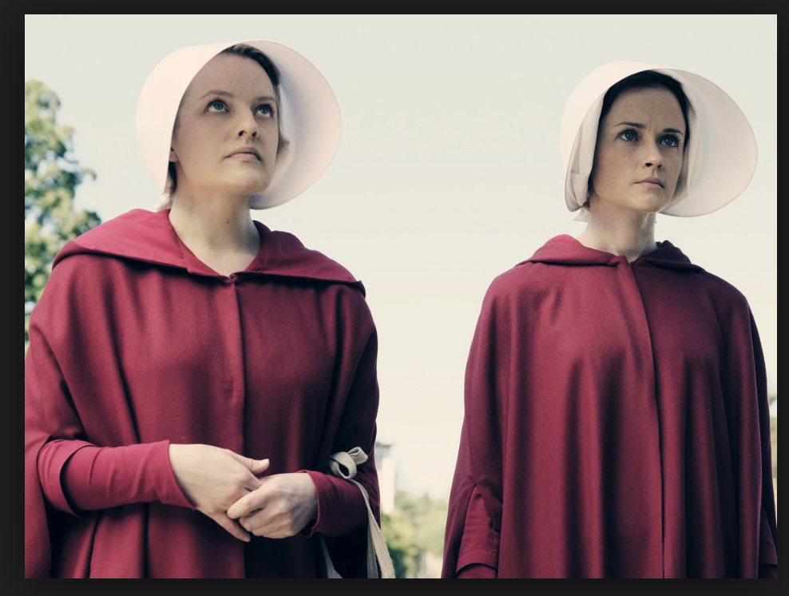
More responses
Image accessed at wired.com
A Chinese TESOL student echoes Law student –
“going out to schools” – “seeing real world examples” – raising questions of how this might be possible.
One interesting response from a student of Business – “more novitiates.”

Slide 16
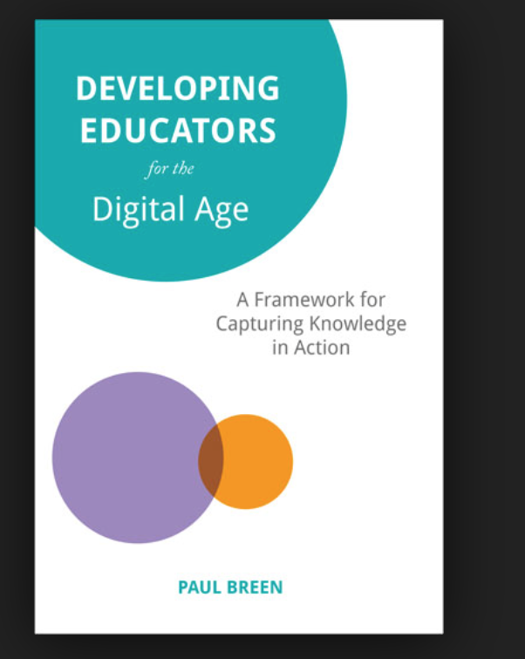
PhD research
Echoes some earlier work that I had done in my PhD research on attitudes of teachers to incorporating technologies into teaching – TPACK perspective (Mishra & Koehler, 2006).

Slide 17
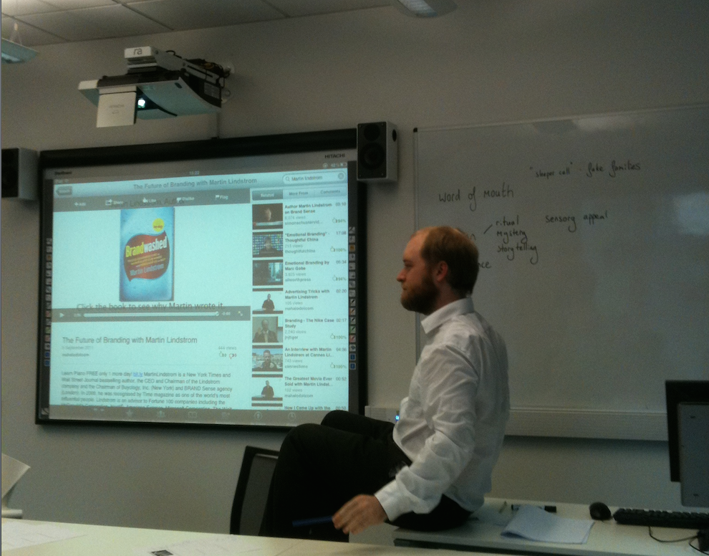

Slide 18
Discussion points
How then as Academic English practitioners can we transform our practices according to such suggestions?
Do we need to? Is that the work of the ‘disciplines’?
Hasn’t ELT been utilising real world interaction for a long time? Are we in EAP sometimes throwing out the good habits with the bad? (paraphrase of Alexander et al, 2008).

Slide 19
References
Alexander, O. Argent, S. & Spencer, J. (2008) EAP Essentials: a teacher’s guide to principles and practice. Reading: Garnet Publishing.
Engeström, Y. (1999). Activity theory and individual and social transformation. Perspectives on activity theory, 19-38.
Mishra, P., & Koehler, M. (2006). Technological pedagogical content knowledge: A framework for teacher knowledge. The Teachers College Record, 108(6), 1017-1054.
Park, J.H. and De Costa, P. (2015). Reframing graduate student writing strategies from an activity theory perspective. Language and Sociocultural Theory, 2(1), pp.25-50.

Slide 20
